Slide 1
Studi Kasus Struct
BOOKING HOTEL

Slide 2
Booking hotel
Satu hotel memiliki banyak kamar.
Satu kamar dapat dipesan (booking) oleh seorang tamu.
satu booking menyatakan 1 pemesanan kamar oleh seorang tamu
Sebuah hotel mempunyai beberapa booking

Slide 3
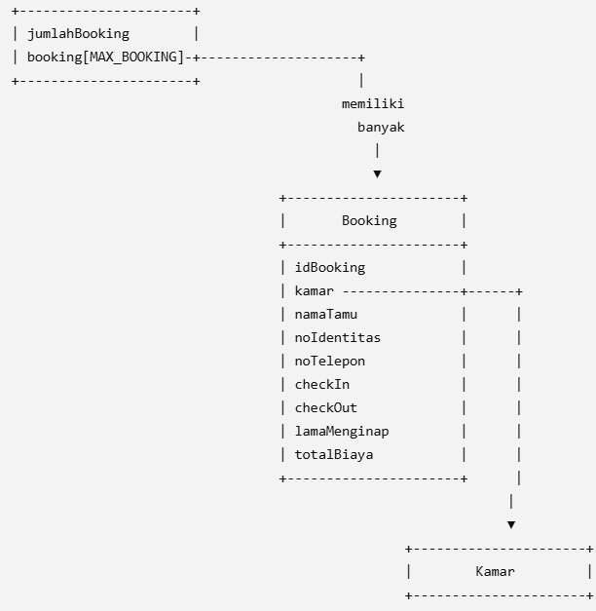
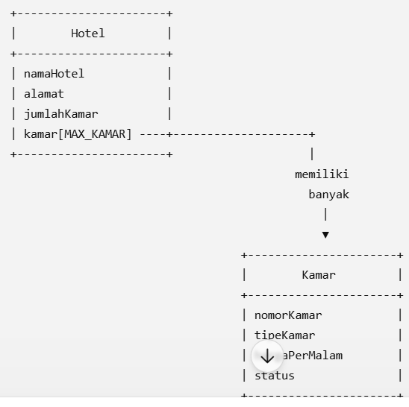
Hubungan antar struct

Slide 4
Struct
// Struct Kamar
struct Kamar {
int nomorKamar;
char tipeKamar[20]; // Standard, Deluxe, Suite float hargaPerMalam;
int status; // 0 = Kosong, 1 = Terbooking
};
#define MAX_KAMAR 100
struct Booking {
int idBooking;
struct Kamar kamar;
char namaTamu[50];
char noIdentitas[20];
char noTelepon[15];
char tanggalCheckIn[15];
char tanggalCheckOut[15];
int lamaMenginap;
float totalBiaya;};
// Struct Hotel
struct Hotel {
char namaHotel[50];
char alamat[100];
int jumlahKamar;
struct Kamar kamar[MAX_KAMAR];
};
#define MAX_BOOKING 100
struct DataBooking {
int jumlahBooking;
struct Booking booking[MAX_BOOKING];
};

Slide 5
Inisialisasi
struct Hotel hotel;
//========================
// Inisialisasi Hotel
//========================
strcpy(hotel.namaHotel, "Hotel AMANAH");
strcpy(hotel.alamat, "Jl. Raya ITS, Surabaya"); hotel.jumlahKamar = 3;
//========================
// Inisialisasi Kamar
//========================
hotel.kamar[0].nomorKamar = 101; strcpy(hotel.kamar[0].tipeKamar, "Standard"); hotel.kamar[0].hargaPerMalam = 300000; hotel.kamar[0].status = 0;
hotel.kamar[1].nomorKamar = 201; strcpy(hotel.kamar[1].tipeKamar, "Deluxe"); hotel.kamar[1].hargaPerMalam = 500000; hotel.kamar[1].status = 0;
hotel.kamar[2].nomorKamar = 301; strcpy(hotel.kamar[2].tipeKamar, "Suite"); hotel.kamar[2].hargaPerMalam = 800000; hotel.kamar[2].status = 0;
struct DataBooking dataBooking;

Slide 6
Jika ada 2 tamu yang booking, maka menambahkan 2 data pada array booking[] di DataBooking.
Misalnya:
Budi memesan kamar 101
Siti memesan kamar 201

Slide 7
Booking 1
Budi memesan kamar 101
dataBooking.jumlahBooking = 2;
// Booking ke-1
dataBooking.booking[0].idBooking = 1;
dataBooking.booking[0].kamar = hotel.kamar[0];
strcpy(dataBooking.booking[0].namaTamu, "Budi");
strcpy(dataBooking.booking[0].noIdentitas, "3578012345678901"); strcpy(dataBooking.booking[0].noTelepon, "081234567890"); strcpy(dataBooking.booking[0].tanggalCheckIn, "10-07-2026"); strcpy(dataBooking.booking[0].tanggalCheckOut, "12-07-2026"); dataBooking.booking[0].lamaMenginap = 2;
dataBooking.booking[0].totalBiaya =
dataBooking.booking[0].lamaMenginap * hotel.kamar[0]. hargaPerMalam;
// Ubah status kamar 101 menjadi terisi
hotel.kamar[0].status = 1; // Kamar 101

Slide 8
Booking 2
Siti memesan kamar 201
// Booking ke-2
dataBooking.booking[1].idBooking = 2;
dataBooking.booking[1].kamar = hotel.kamar[1];
strcpy(dataBooking.booking[1].namaTamu, "Siti");
strcpy(dataBooking.booking[1].noIdentitas, "3578012345678902");
strcpy(dataBooking.booking[1].noTelepon, "082345678901");
strcpy(dataBooking.booking[1].tanggalCheckIn, "11-07-2026");
strcpy(dataBooking.booking[1].tanggalCheckOut, "14-07-2026");
dataBooking.booking[1].lamaMenginap = 3;
dataBooking.booking[1].totalBiaya = dataBooking.booking[1].lamaMenginap * hotel.kamar[1].hargaPerMalam;
// Ubah status kamar 201 menjadi terisi
hotel.kamar[1].status = 1; // Kamar 201

