Slide 1
Heuristic Search

Slide 2
Heuristic Search
Best First Search
A*

Slide 3
Heuristic Search
Heuristic search exploits additional knowledge about the problem that helps direct search to more promising paths.
A heuristic function that gives us an estimate of how far we are from a goal.
Example:
How do we use heuristics?

Slide 4
Sometimes we can tell that some states appear better that others...
7
8
4
1
2
3
3
5
1
4
5
6
6
2
7
8
FWD
D
C
FW C

Slide 5
Informed Search
Add domain-specific information to select the best path along which to continue searching
Define a heuristic function, h(n), that estimates the “goodness” of a node n.
Specifically, h(n) = estimated cost (or distance) of minimal cost path from n to a goal state.
The heuristic function is an estimate, based on domain-specific information that is computable from the current state description, of how close we are to a goal

Slide 6
Greedy Search
f(N) = h(N) → greedy best-first

Slide 7
Heuristic Function
Function h(N) that estimate the cost of the cheapest path from node N to goal node.
Example: 8-puzzle
5
8
1
2
3
h(N) = number of misplaced tiles = 6
4
2
1
4
5
6
7
3
6
7
8
N
goal

Slide 8
Heuristics for 8-puzzle II
3
2
8
3
3
Current State
2 spaces
4
5
6
7
1
The Manhattan Distance (not including the blank)
8
1
2
3
Goal State
3 spaces
4
5
6
8
7
8
1
In this case, only the “3”, “8” and “1” tiles are misplaced, by 2, 3, and 3 squares respectively, so the heuristic function evaluates to 8.
In other words, the heuristic is telling us, that it thinks a solution is available in just 8 more moves.
3 spaces
1
Total 8
Notation: h(n) h(current state) = 8

Slide 9
Heuristic Function
Function h(N) that estimate the cost of the cheapest path from node N to goal node.
Example: 8-puzzle
5
8
1
2
3
h(N) = sum of the distances of
every tile to its goal position
= 2 + 3 + 0 + 1 + 3 + 0 + 3 + 1
= 13
4
2
1
4
5
6
7
3
6
7
8
N
goal

Slide 10
Robot Navigation

Slide 11
Robot Navigation
f(N) = h(N), with h(N) = Manhattan distance to the goal
8
7
6
5
4
3
2
3
4
5
6
7
5
4
3
5
6
3
2
1
0
1
2
4
7
6
5
8
7
6
5
4
3
2
3
4
5
6

Slide 12
Robot Navigation
f(N) = h(N), with h(N) = Manhattan distance to the goal
8
7
6
5
4
3
2
3
4
5
6
7
5
4
3
5
6
3
2
1
0
0
1
2
4
7
7
6
5
8
7
6
5
4
3
2
3
4
5
6

Slide 13
8-Puzzle
5
8
1
2
3
4
2
1
4
5
6
7
3
6
7
8
N
goal
h1(N) = number of misplaced tiles = 6
h2(N) = sum of distances of each tile to goal = 13

Slide 14
8-Puzzle
Where score function for a non-central tile is 2 if it is not followed by the correct tile in clockwise order and 0 otherwise
h3(N) = (sum of distances of each tile to goal) + 3 x (sum of score functions for each tile) = 2+3+0+1+3+0+3+1+3x(2+2+2+2+2+0+2) = 49 is not admissible

Slide 15
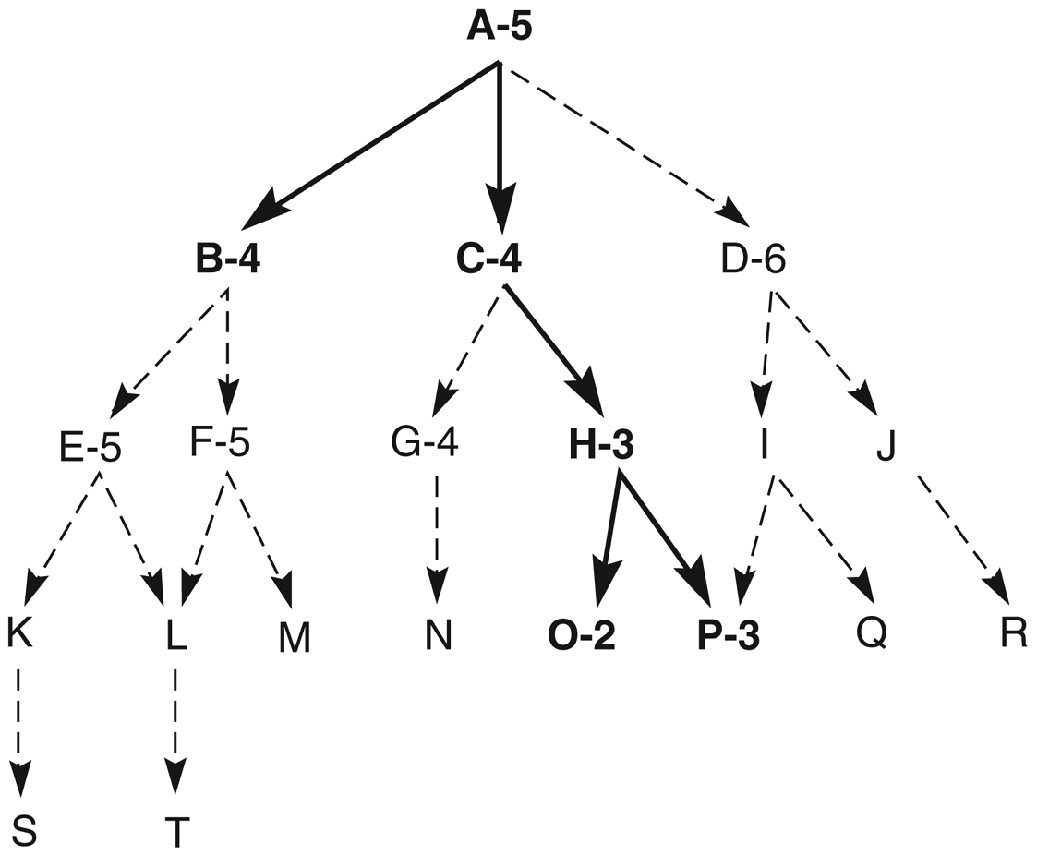
Heuristic search of a hypothetical state space (Fig. 4.4)
node
The heuristic value
of the node

Slide 16
Take the DFS algorithm
Function depth_first_search;
begin open := [Start]; closed := [ ]; while open ≠ [ ] do begin remove leftmost state from open, call it X; if X is a goal then return SUCCESS else begin generate children of X; put X on closed; discard remaining children of X if already on open or closed put remaining children on left end of open end end; return FAIL end.

Slide 17
Add the children to OPEN with respect to their heuristic value
Function best_first_search;
begin open := [Start]; closed := [ ]; while open ≠ [ ] do begin remove leftmost state from open, call it X; if X is a goal then return SUCCESS else begin generate children of X; assign each child their heuristic value; put X on closed; (discard remaining children of X if already on open or closed) put remaining children on open sort open by heuristic merit (best leftmost) end end; return FAIL end.
new
will be handled differently

Slide 18
Heuristic search of a hypothetical state space

Slide 19
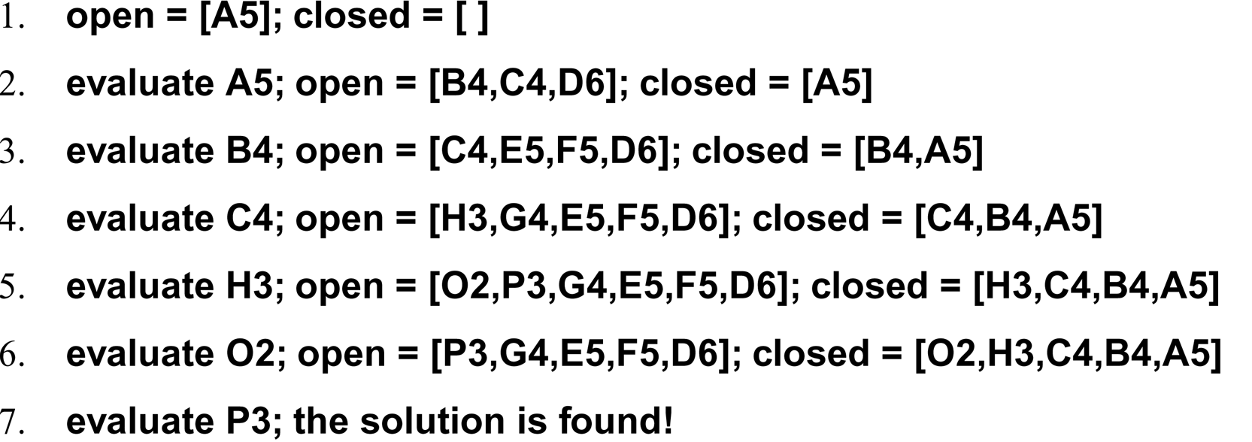
A trace of the execution of best_first_search for Fig. 4.4

Slide 20
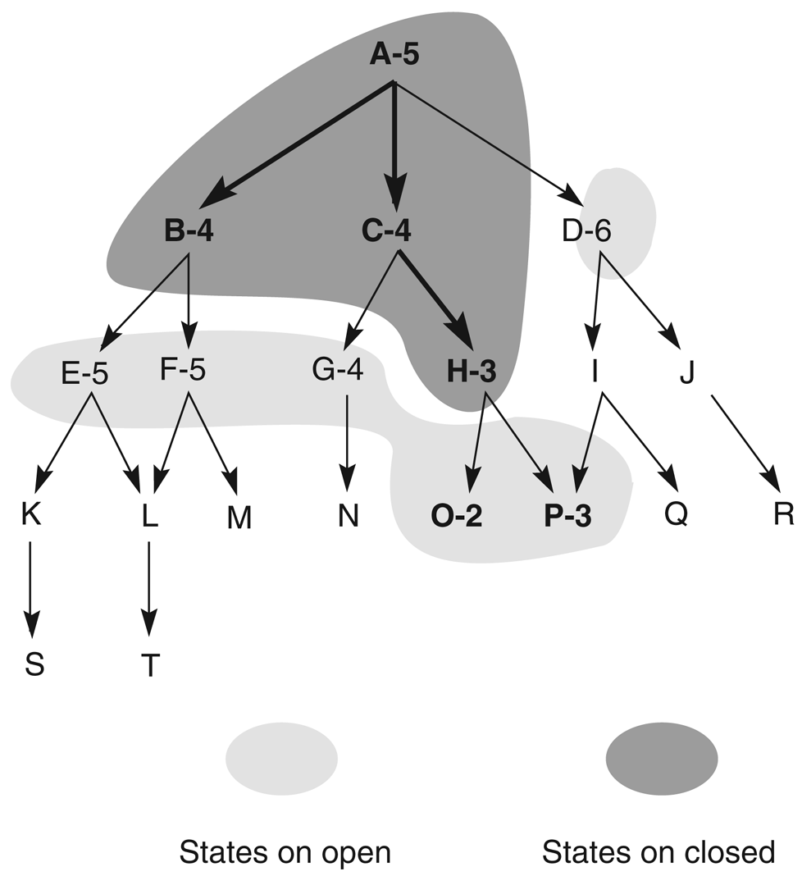
Heuristic search of a hypothetical state space with open and closed highlighted

Slide 21
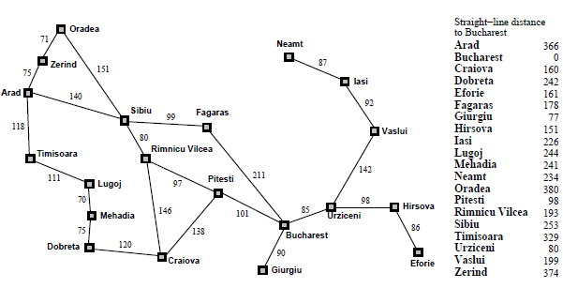
Greedy BFS Example

Slide 22
Greedy best-first search example

Slide 23
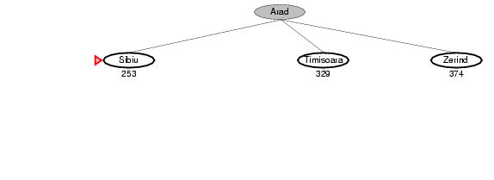
Greedy best-first search example

Slide 24
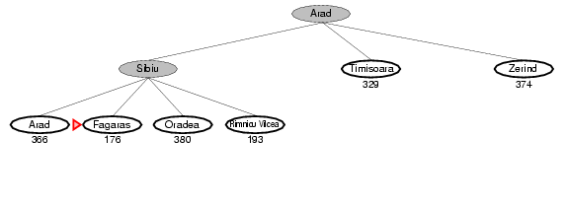
Greedy best-first search example

Slide 25
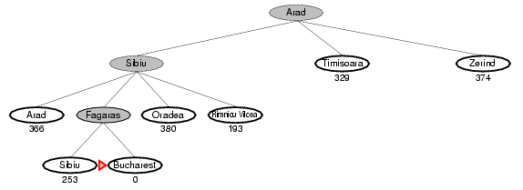
Greedy best-first search example

Slide 26
A Quick Review - Again
g(n) = cost from the initial state to the current state n
h(n) = estimated cost of the cheapest path from node n to a goal node
f(n) = evaluation function to select a node for expansion (usually the lowest cost node)

Slide 27
A* Search
A* (A star) is the most widely known form of Best-First search
It evaluates nodes by combining g(n) and h(n)
f(n) = g(n) + h(n)
Where
g(n) = cost so far to reach n
h(n) = estimated cost to goal from n
f(n) = estimated total cost of path through n

Slide 28
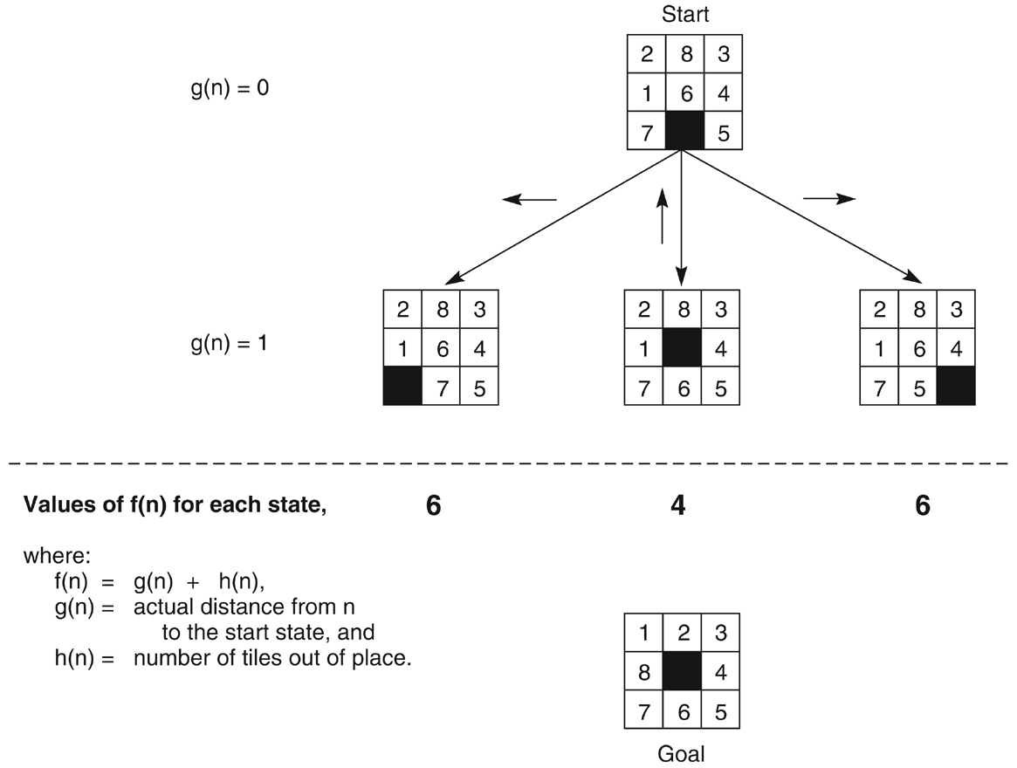
The heuristic f applied to states in the 8-puzzle

Slide 29
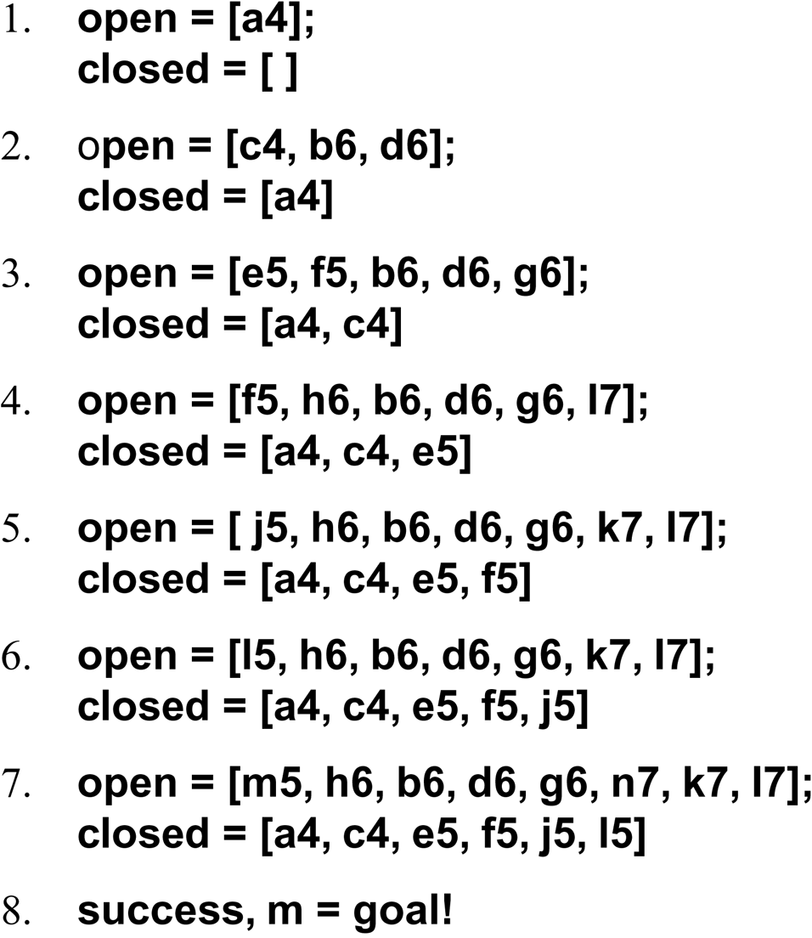
The successive stages of OPEN and CLOSED

Slide 30
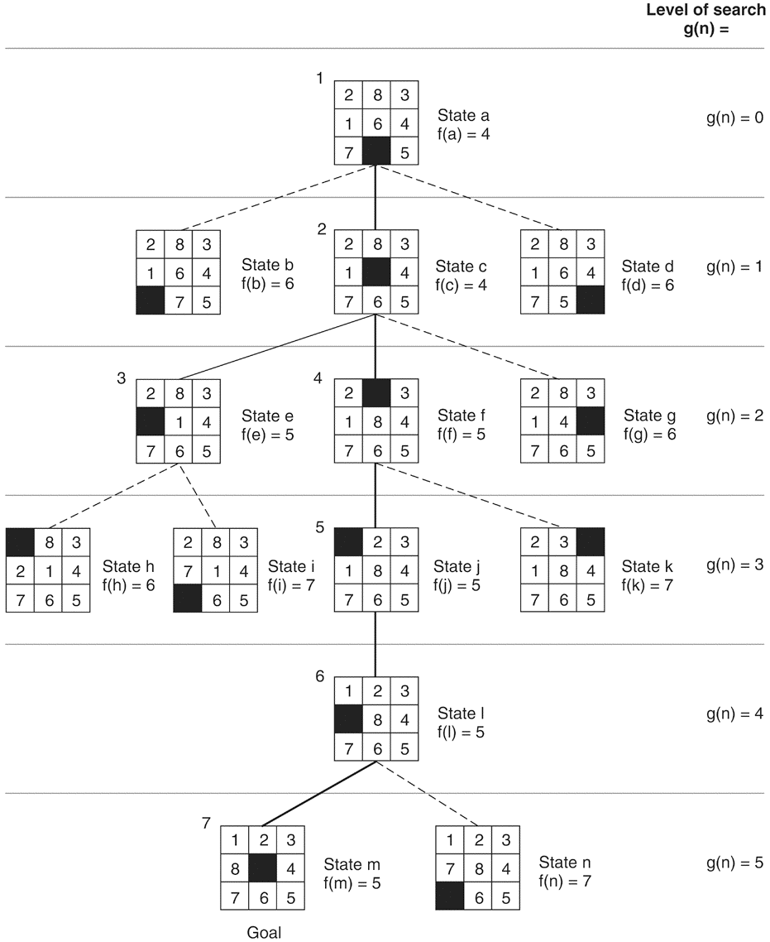

Slide 31
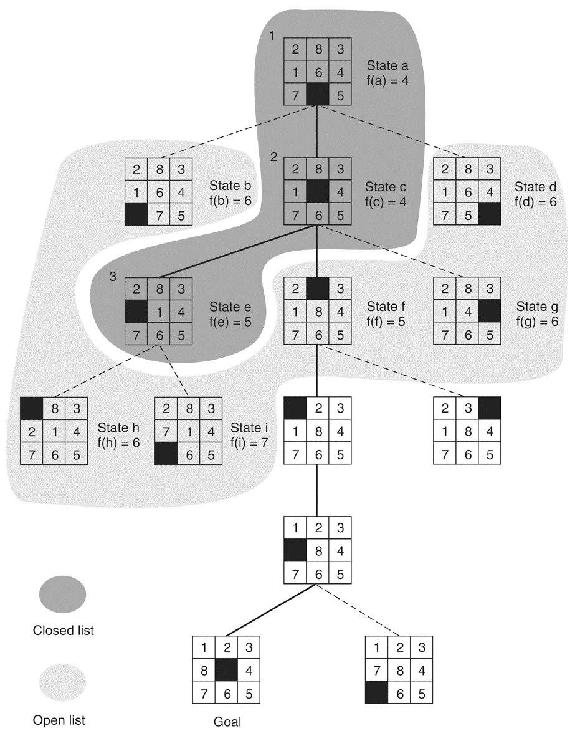

Slide 32
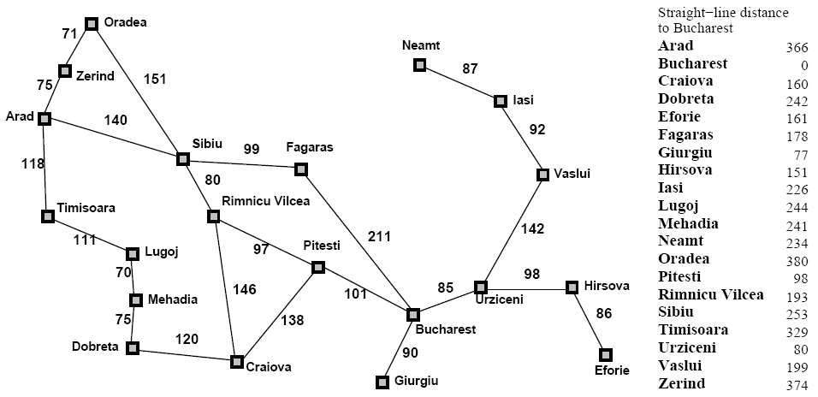
Greedy Best-First Search

Slide 33
A* Search

Slide 34
A* Search

Slide 35
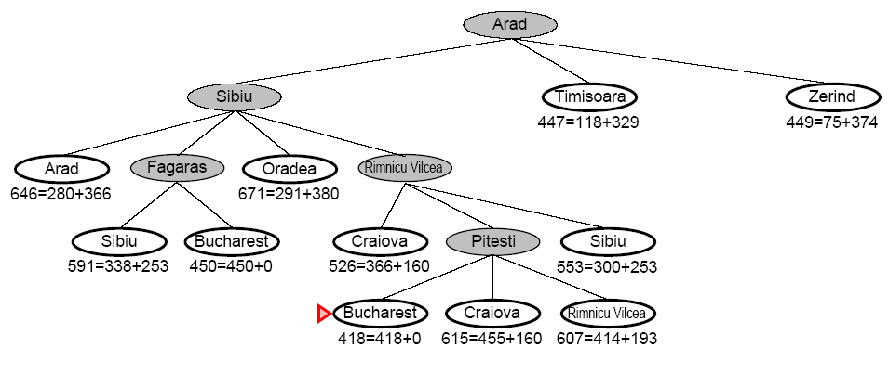
A* Search

Slide 36
8-Puzzle
f(N) = h(N) = number of misplaced tiles
3
3
4
5
3
4
2
4
2
1
goal
3
3
0
4
5
4

Slide 37
8-Puzzle
f(N) = h(N) = Σ distances of tiles to goal
6
5
2
5
2
1
goal
4
3
0
4
6
5

Slide 38
8-Puzzle
f(N) = g(N) + h(N)
with h(N) = number of misplaced tiles
3+3
1+5
2+3
3+4
5+2
0+4
3+2
4+1
goal
1+3
2+3
5+0
3+4
1+5
2+4

Slide 39
Robot Navigation
f(N) = g(N)+h(N), with h(N) = Manhattan distance to goal
8+3
8+3
7+4
7+4
6+5
6+3
5+6
5+6
4+7
4+7
3+8
3+8
2+9
8
7
6
5
4
3
2+9
3+10
2
3
4
5
6
7+2
7+2
5+6
4+7
3+8
7
5
4
3+8
3
5
6+1
6+1
2+9
2+9
1+10
6
3
2
1+10
0+11
1
0
1
2
4
7+0
7+0
6+1
7
6+1
6
5
8+1
8+1
7+2
7+2
6+3
6+3
5+4
5+4
4+5
4+5
3+6
3+6
2+7
8
7
6
5
4
3
2+7
3+8
2
3
4
5
6

Slide 40
Iterative Deepening A* (IDA*)
Use f(N) = g(N) + h(N) with admissible and consistent h
Each iteration is depth-first with cutoff on the value of f of expanded nodes

Slide 41
8-Puzzle
f(N) = g(N) + h(N)
with h(N) = number of misplaced tiles
4
Cutoff=4
6

Slide 42
8-Puzzle
f(N) = g(N) + h(N)
with h(N) = number of misplaced tiles
4
Cutoff=4
4
6
6

Slide 43
8-Puzzle
f(N) = g(N) + h(N)
with h(N) = number of misplaced tiles
4
Cutoff=4
4
5
6
6

Slide 44
8-Puzzle
f(N) = g(N) + h(N)
with h(N) = number of misplaced tiles
5
4
Cutoff=4
4
5
6
6

Slide 45
8-Puzzle
f(N) = g(N) + h(N)
with h(N) = number of misplaced tiles
6
5
4
Cutoff=4
4
5
6
6

Slide 46
8-Puzzle
f(N) = g(N) + h(N)
with h(N) = number of misplaced tiles
4
Cutoff=5
6

Slide 47
8-Puzzle
f(N) = g(N) + h(N)
with h(N) = number of misplaced tiles
4
Cutoff=5
4
6
6

Slide 48
8-Puzzle
f(N) = g(N) + h(N)
with h(N) = number of misplaced tiles
4
Cutoff=5
4
5
6
6

Slide 49
8-Puzzle
f(N) = g(N) + h(N)
with h(N) = number of misplaced tiles
4
Cutoff=5
4
5
7
6
6

Slide 50
8-Puzzle
f(N) = g(N) + h(N)
with h(N) = number of misplaced tiles
4
5
Cutoff=5
4
5
7
6
6

Slide 51
8-Puzzle
f(N) = g(N) + h(N)
with h(N) = number of misplaced tiles
4
5
5
Cutoff=5
4
5
7
6
6

Slide 52
8-Puzzle
f(N) = g(N) + h(N)
with h(N) = number of misplaced tiles
4
5
5
Cutoff=5
4
5
7
6
6

Slide 53
About Heuristics
Heuristics are intended to orient the search along promising paths
The time spent computing heuristics must be recovered by a better search
After all, a heuristic function could consist of solving the problem; then it would perfectly guide the search
Deciding which node to expand is sometimes called meta-reasoning
Heuristics may not always look like numbers and may involve large amount of knowledge

Slide 54
When to Use Search Techniques?
The search space is small, and
There is no other available techniques, or
It is not worth the effort to develop a more efficient technique
The search space is large, and
There is no other available techniques, and
There exist “good” heuristics

