Slide 1
Android Using Menus
Politeknik Elektronika Negeri Surabaya

Slide 2
Outline
ContextMenu
OptionMenu

Slide 3
Using Menus
Menus is not consuming ‘much’ view space.
Android provides two types of menu known as: options menu and context menu.
The options menu is triggered by pressing the hardware Menu button on the device, while
The context menu is raised by a tap-and-hold on the widget associated to the menu.

Slide 4
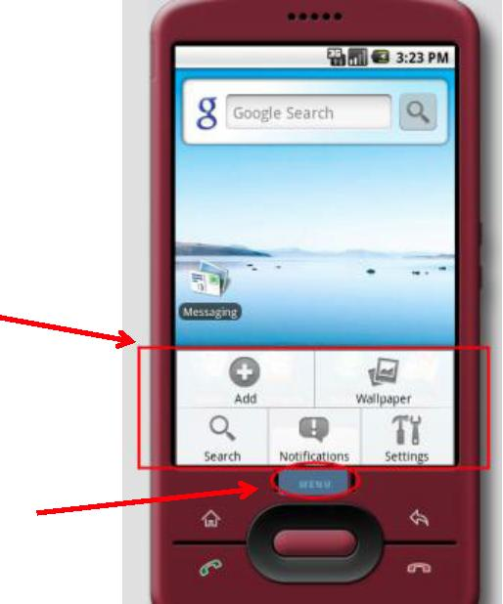
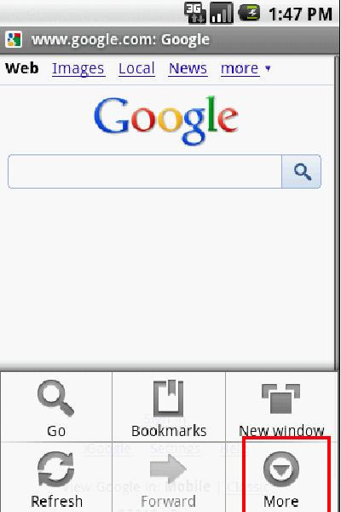
Using Menus
Example: Using an option menu
Options available in this context
Press Menu Button
A max of six entries per menu. Excess will be displayed as part of the More option

Slide 5
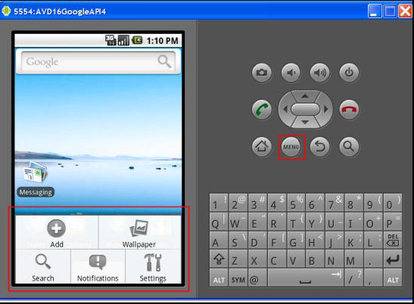
Using Menus
Example: Using an option menu
Press Menu
button
Available
Options in
this context

Slide 6
Using Menus (Android 4)

Slide 7
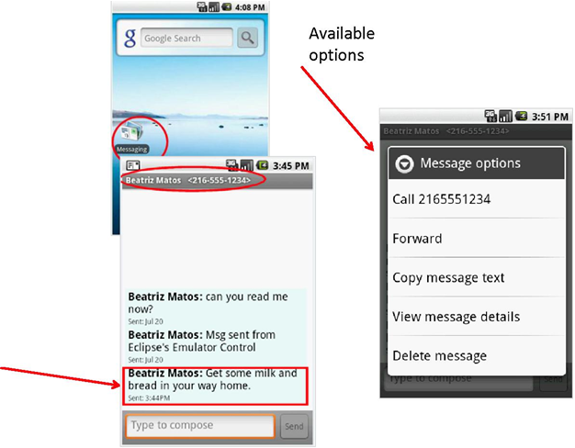
Using Menus
Example :
Dealing with SMS (text-messages) by using the built-in Messaging app’s
context menu
Tap-&-Hold

Slide 8
Using Menus
Comments on Creating Context Menu
Indicate which widget(s) on your activity have context menus. To do this, call
registerForContextMenu(theWidget)
supplying the View that is the widget needing a context menu.
Implement onCreateContextMenu(…)
To find out when a context menu choice was chosen, implement onContextItemSelected() on the activity.

Slide 9
Using Menus - Option Menu (1)
Comments on Creating Option Menu
Pressing the hardware Menu button on the device.
Implement onCreateOptionMenu(…)
To find out when a option menu choice was chosen, implement onOptionItemSelected() on the activity.

Slide 10
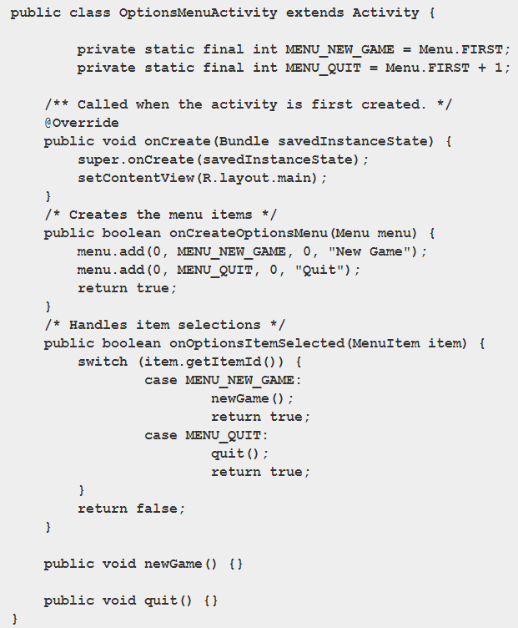
Adding Menu

Slide 11
Adding Menu
Given that we have received a Menu object via onCreateOptionsMenu(), we add menu choices by calling add(). There are many flavors of this method, which require some combination of the parameters as following:
A group identifier (groupId): This should be NONE unless we are creating a specific grouped set of menu choices for use with setGroupCheckable().
A choice identifier (itemId): This is for use in identifying this choice in the onOptionsItemSelected() callback when a menu choice is selected.
An order identifier (order): To indicate where this menu choice should be slotted if the menu has Android-supplied choices alongside our own; for now, just use NONE.
The text of the menu choice, as a String or a resource ID (title).

Slide 13
Adding Icons
Icons can also be added to items that appears in the Icon Menu with setIcon(). For example, if we modify one of the line in the Java code above after put icon into res/drawable/:
menu.add(0, MENU_QUIT, 0, Quit").setIcon(R.drawable.ic_quit);

Slide 14
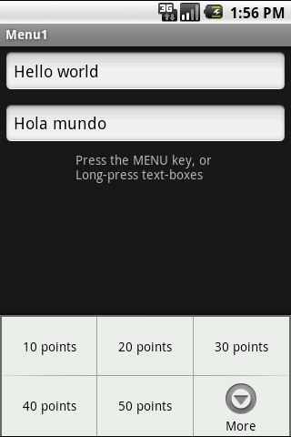
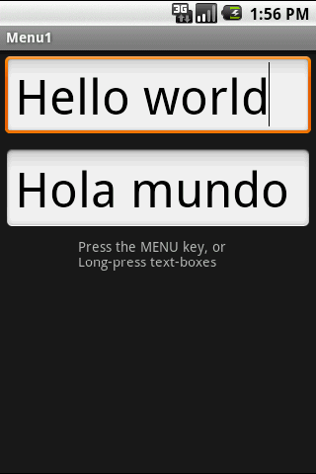
Using Menus Example 1
Example 1: Using an Option Menu
In this application the Option menu offers a way of changing the text size (on both EditText boxes)
Click on Menubutton to see size options
After choosing option:
50 points

Slide 15
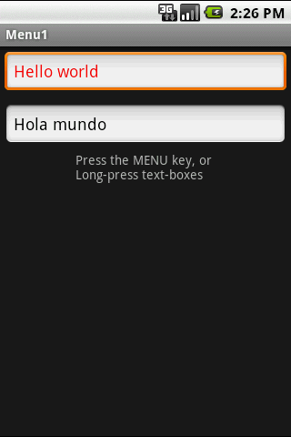
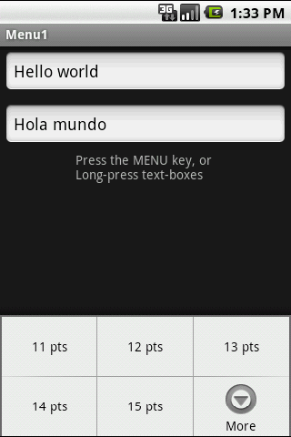
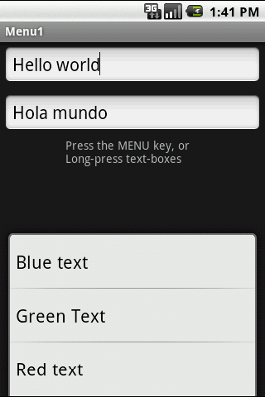
Using Menus Example 1
Example 1: Using an Option Menu
Up to six options will be displayed on the Option menu.
If there are more than six options pushing the More button will show the rest
Click the More button to see additional options
Additional choices of the Option menu

Slide 16
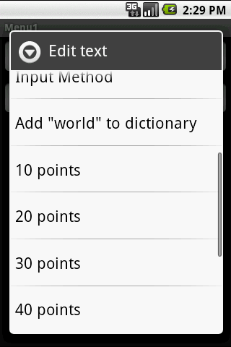
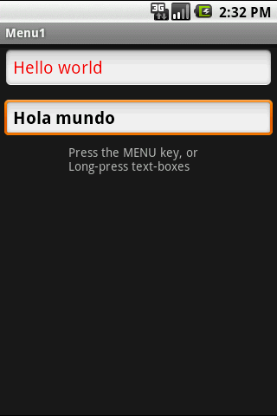
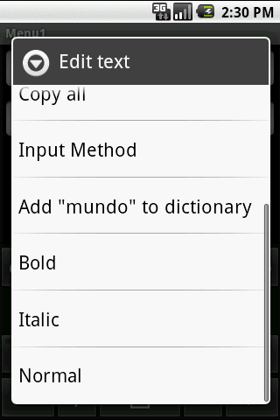
Using Menus Example 1
Example 1: Using a Context Menu
Each view could have an associated
Context Menu
Long-press a textbox to invoke its Context Menu

Slide 17
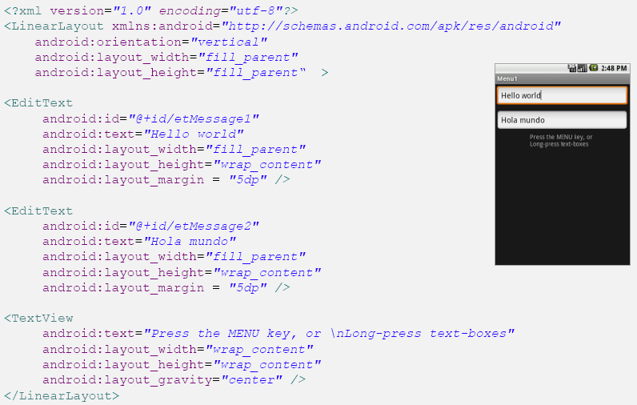
Using Menus Example 1
Example 1: Using Option and Context Menu
The app shows two text boxes. Menus are used to change text’s size, color, and style.

Slide 18
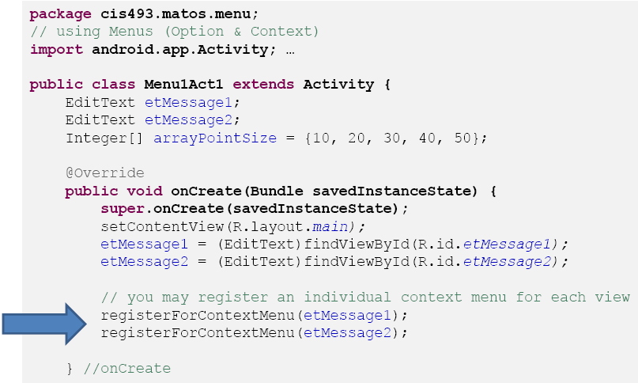
Using Menus Example 1
Example 1: Using Option and Context Menu
The app shows two text boxes. Menus are used to change text’s size, color, and style.

Slide 19
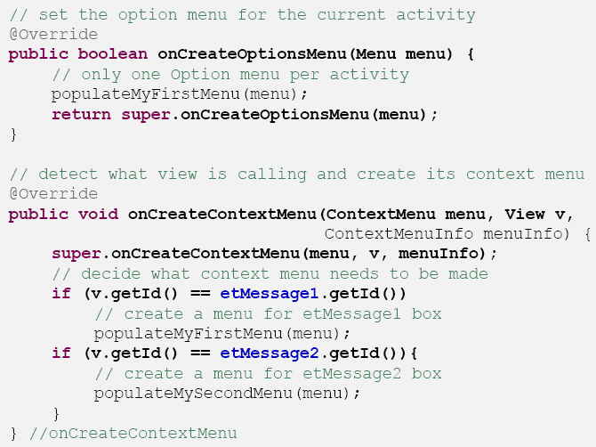
Using Menus Example 1
Example 1: Using Option and Context Menu
The app shows two text boxes. Menus are used to change text’s size, color, and style.

Slide 20
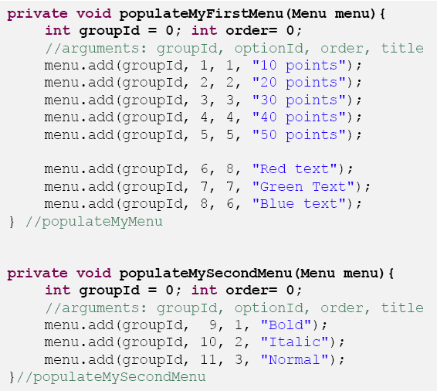
Using Menus Example 1
Example 1: Using Option and Context Menu
The app shows two text boxes. Menus are used to change text’s size, color, and style.

Slide 21
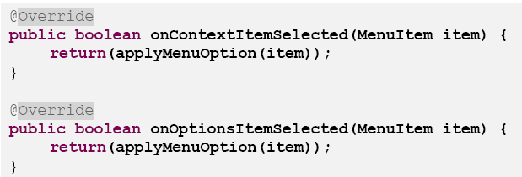
Using Menus Example 1
Example 1: Using Option and Context Menu
The app shows two text boxes. Menus are used to change text’s size, color, and style.

Slide 22
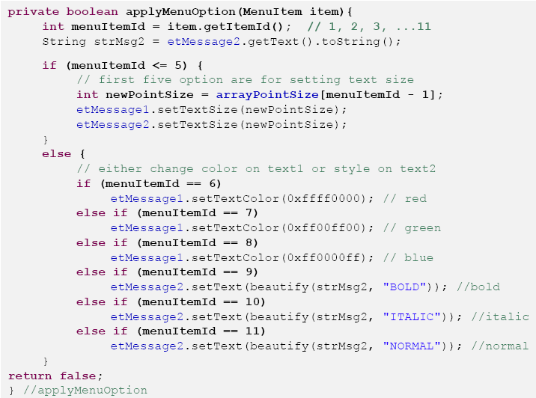
Using Menus Example 1
Example 1: Using Option and Context Menu
The app shows two text boxes. Menus are used to change text’s size, color, and style.

Slide 23
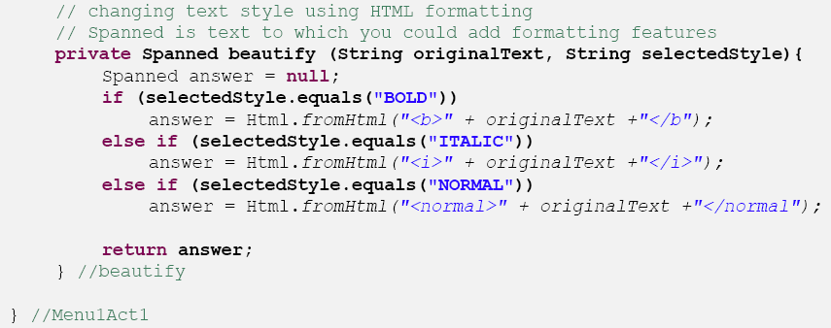
Using Menus Example 1
Example 1: Using Option and Context Menu
The app shows two text boxes. Menus are used to change text’s size, color, and style.

Slide 24
Adding Menu (2) - Menu in XML
res/menu/my_menu.xml

Slide 25
Adding Menu (2) - Menu in XML
strings.xml

Slide 26
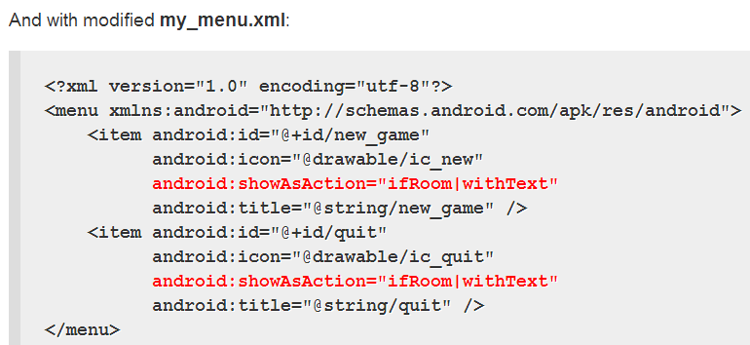
Action Bar

Slide 27
Menu Example - XML
Layout:
<?xml version="1.0" encoding="utf-8"?>
<LinearLayout xmlns:android=http://schemas.android.com/apk/res/android
android:orientation="vertical" android:layout_width="fill_parent" android:layout_height="fill_parent">
<TextView android:layout_width="fill_parent" android:layout_height="wrap_content"
android:text="Click on the option menu and play with the choices!"/>
</LinearLayout>

Slide 28
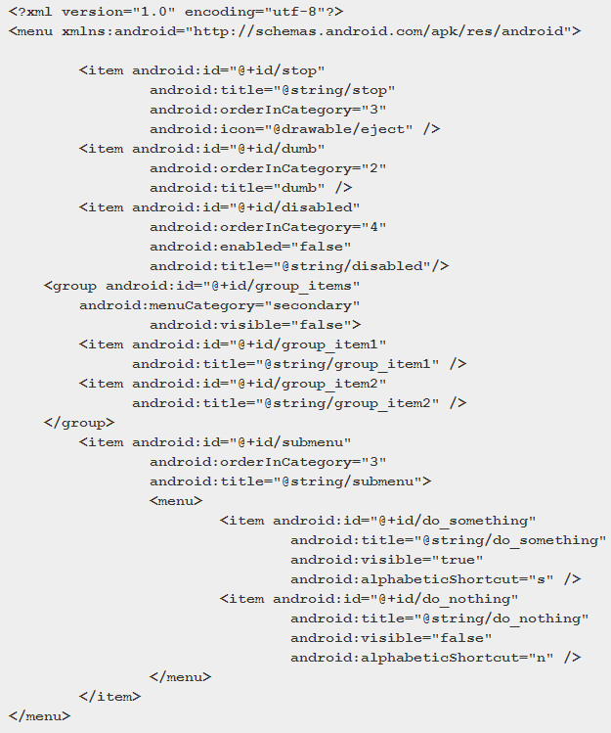
Menus in XML

Slide 29
menu.xml
We must start with a menu root element.
Inside a menu element are item elements and group elements. The group element represents a collection of menu items that can be operated upon as a group.
When creating our menu resource, we can create a submenu by adding a <menu> element as the child of an <item>. In other words, submenus are specified by adding a menu element as a child of an item element, using this new menu element to describe the contents of the submenu.
If we want to detect when an item is chosen, or to reference an item or group from our Java code, be sure to apply an android:id, just as do with View layout XML.

Slide 30
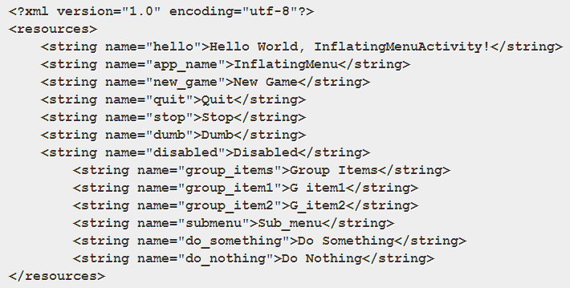
String.xml

Slide 31
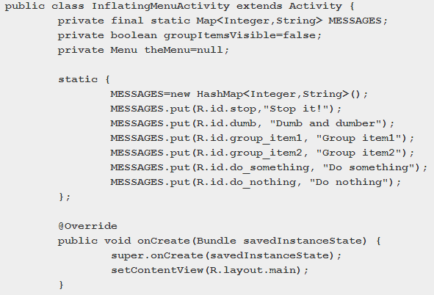
Java Code

Slide 32
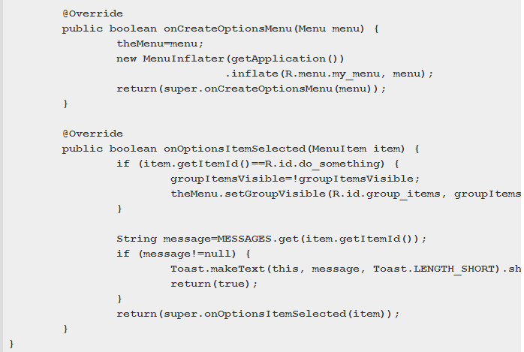
Java Code

Slide 33
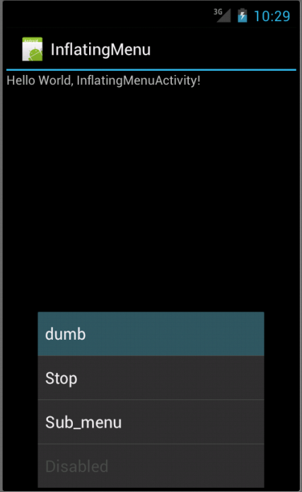

Slide 34
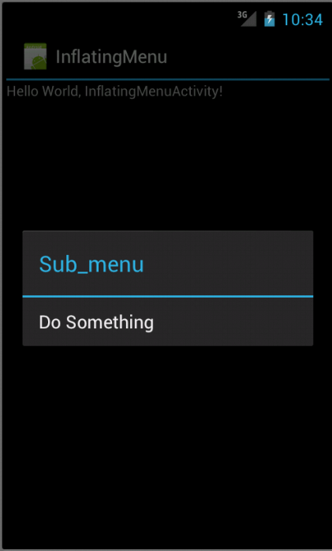
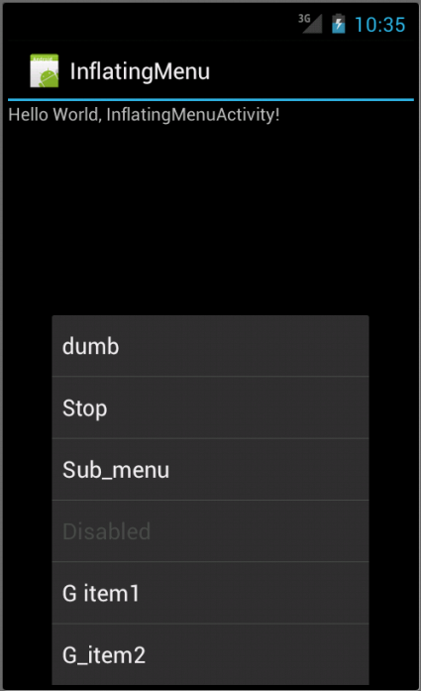

Slide 35
Menu Icons
high-density (hdpi) Full Asset: 72 x 72 px Icon: 48 x 48 px Square Icon: 44 x 44 px
medium-density (mdpi) Full Asset: 48 x 48 px Icon: 32 x 32 px Square Icon: 30 x 30 px
low-density (ldpi) Full Asset: 36 x 36 px Icon: 24 x 24 px Square Icon: 22 x 22

Slide 36
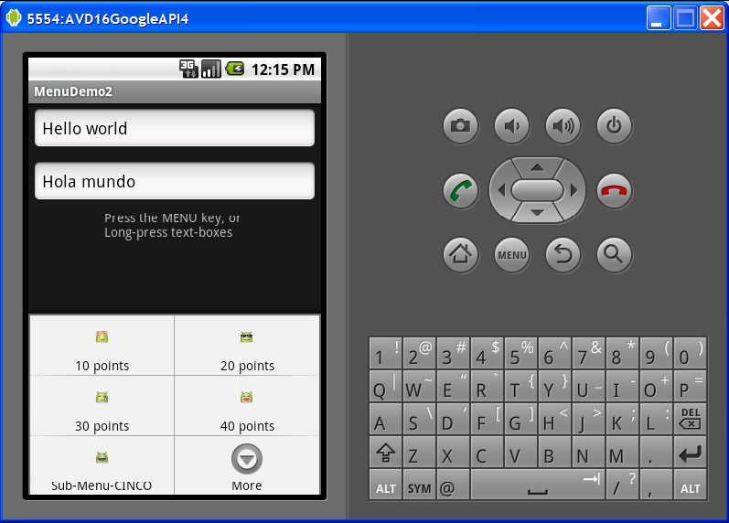
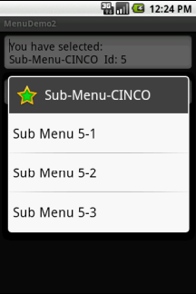
Using Menu Example 2
Example 2: Enhancing Option/Context Menu
This extension of the previous example adds icons and links to the Option Menu entries, as well as a sub-menu list tied to one the option menu buttons.
Click on SubMenu to see additional options

Slide 37
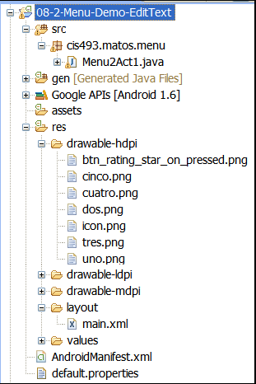
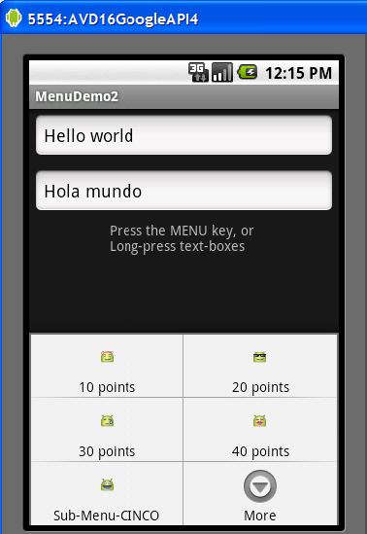
Using Menu Example 2
Example 2: Enhancing Option/Context Menu
This extension of the previous example adds icons and linksto the Option Menu entries, as well as a sub-menu list tied to one the option menu buttons.

Slide 38
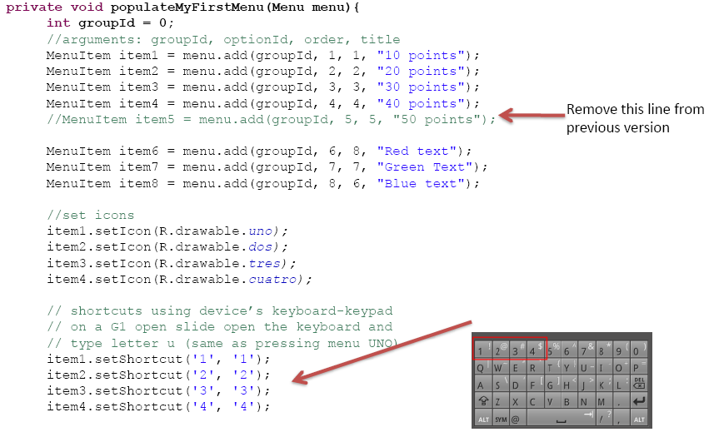
Using Menu Example 2
Replace the method
populateMyFirstMenu
with the following code
Example 2: Enhancing Option/Context Menu

Slide 39
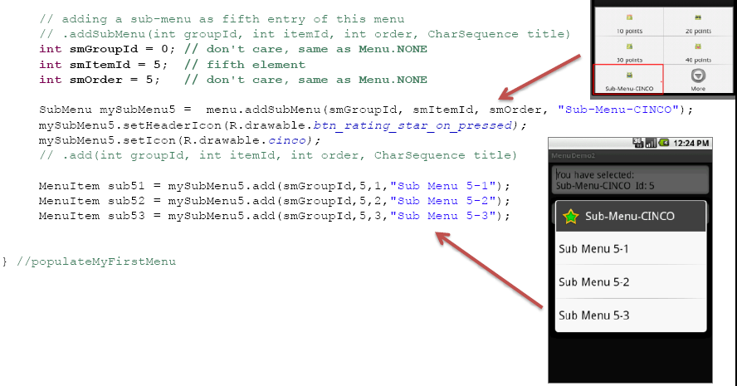
Using Menu Example 2
Continuation…
Replace the method
populateMyFirstMenu
with the following code
Example 2: Enhancing Option/Context Menu

Slide 40
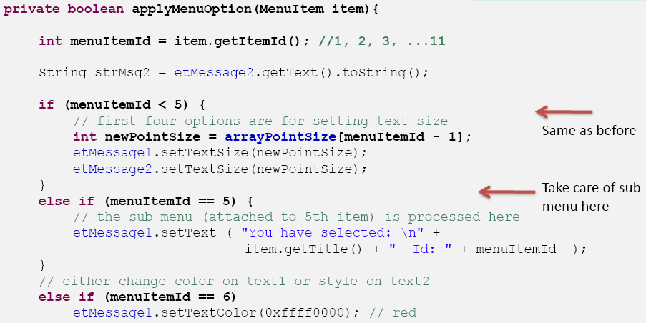
Using Menu Example 2
Continuation…
Replace the method
applyMenuOption
with the following code
Example 2: Enhancing Option/Context Menu

Slide 41
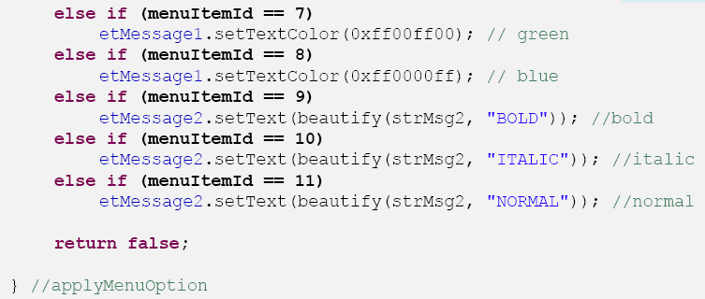
Using Menu Example 2
Continuation…
Replace the method
applyMenuOption
with the following code
Same as before
Example 2: Enhancing Option/Context Menu

Slide 42
Using Menu
Comments on Creating Submenus
Submenus are displayed as regular Menus Items. When selected they just display more options.
To avoid cluttered UIs, submenus are not displayed using three-like structure, instead they appear as a simple floating window presenting a list of items.
Android does not support nested submenus.

Slide 43
Using Menu
Comments on Creating Submenus
Example:
Extend previous example by adding a fifth entry to the existing menu list. The new entry is of the SubMenutype. It should offer three options of its own.
Note: add this code to the end of the: onCreateOptionsMenu(…)method.

Slide 44
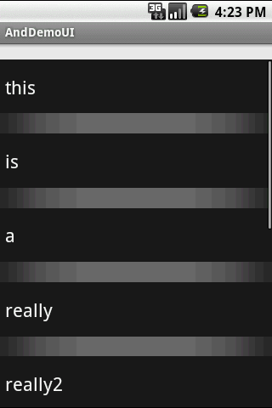
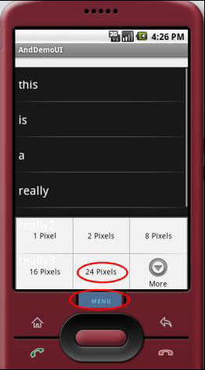
Using Menu Example 3
Example 3: Using Option/Context Menu
Observe how the selection made from the Menu changes the inter-row spacing of the ListView.
Click on Menu to see spacing options
After choosing option:
24 Pixels
of row separation

Slide 45
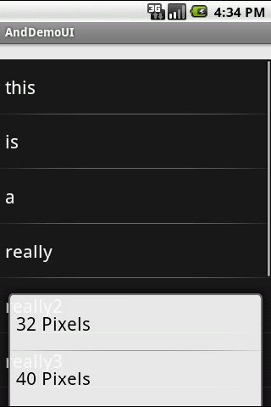
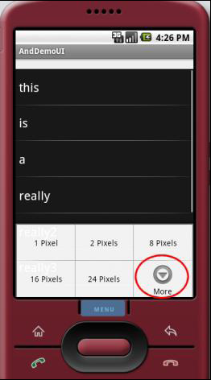
Using Menu Example 3
Example 3: Using Option
Click on Menu to see spacing options
After choosing option:
More
a new menu is shown

Slide 46
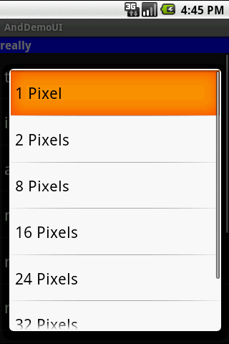
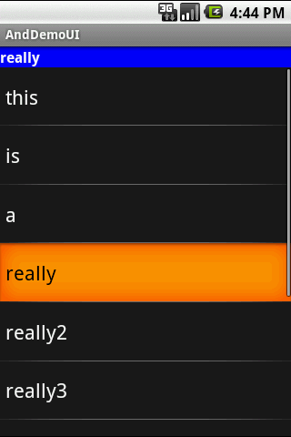
Using Menu Example 3
Example 3: Using a Context Menu
Tap & Hold
any row to bring
Context Menu
Choices listed in a floating
ListView

Slide 47
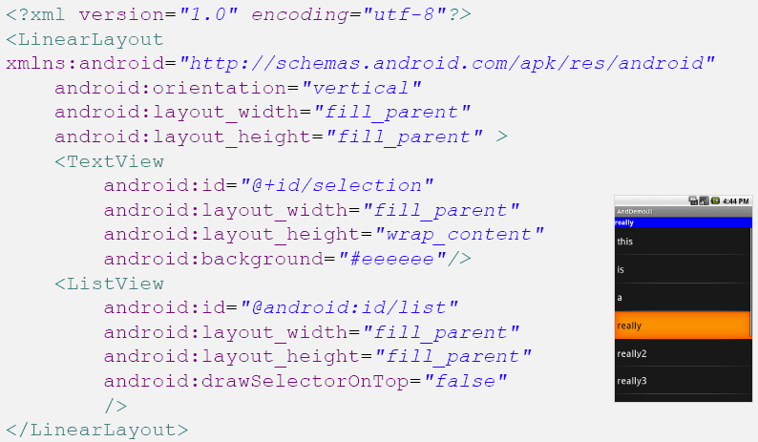
Using Menu Example 3
Example 3: Creating an Option & Context Menu

Slide 48
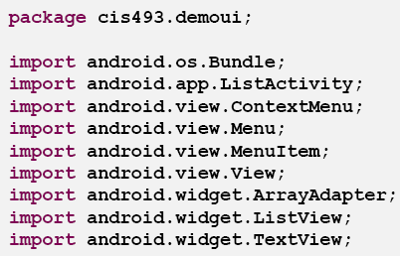
Using Menu Example 3
Example 3: Creating an Option & Context Menu

Slide 49
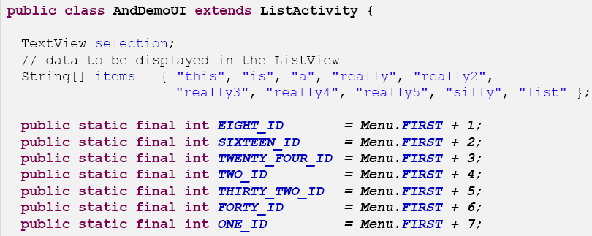
Using Menu Example 3
Example 3: Creating an Option & Context Menu

Slide 50
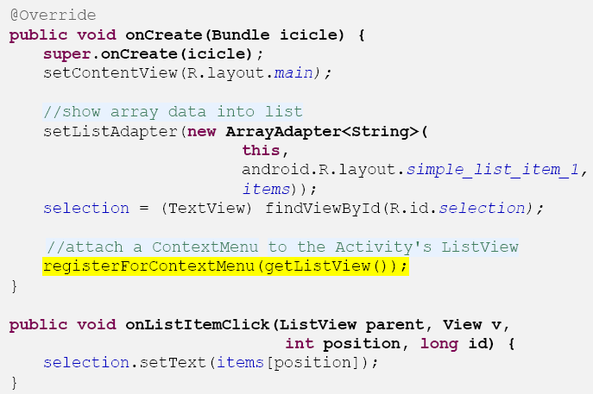
Using Menu Example 3
Example 3: Creating an Option & Context Menu

Slide 51
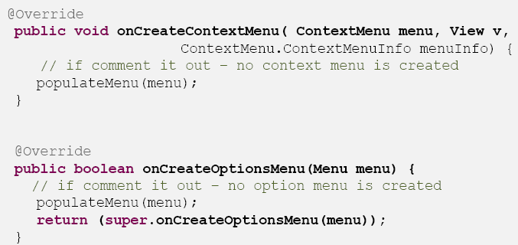
Using Menu Example 3
Example 3: Creating an Option & Context Menu

Slide 52
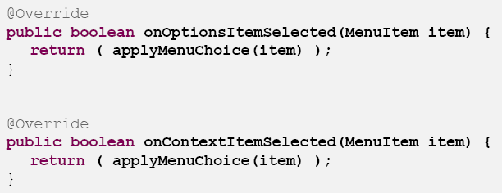
Using Menu Example 3
Example 3: Creating an Option & Context Menu

Slide 53
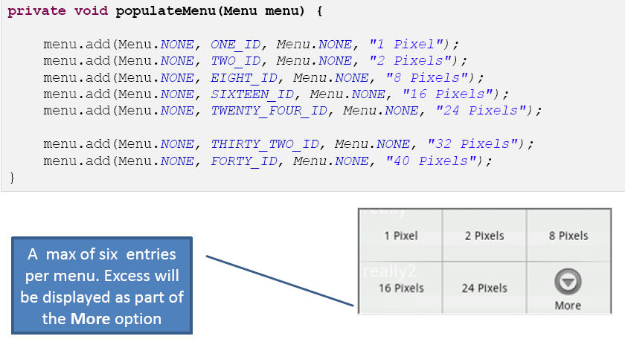
Using Menu Example 3
Example 3: Creating an Option & Context Menu

Slide 54
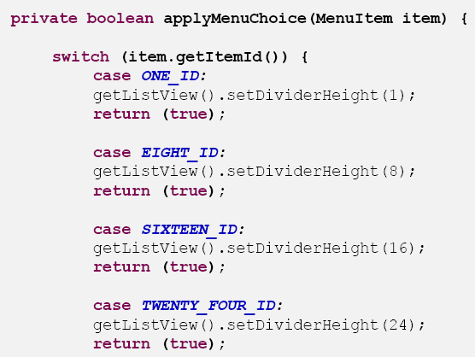
Using Menu Example 3
Example 3: Creating an Option & Context Menu

Slide 55
Using Menu Example 3
Example 3: Creating an Option & Context Menu

Slide 56
Using Menu Example 4
Example 4: Another App Using Menus that include Icons & Text
This is a simple application designed around a TableLayout.
1. The first row shows a summary of the data collected from the screen.
2. The second row exposes a RadioGroupand a textBox.
3. The third row shows a list of the calls made to the option and context menus.
This Option Menu shows its options using text & icons

Slide 57
Using Menu Example 4
Example 4: Another App Using Menus that include Icons & Text
Application’s Layout

Slide 58
Using Menu Example 4
Example 4: Another App Using Menus that include Icons & Text
Application’s Layout.
Hierarchy View

Slide 59
Using Menu Example 4

Slide 60
Using Menu Example 4

Slide 61
Using Menu Example 4

Slide 62
Using Menu Example 4

Slide 63
Using Menu Example 4
Example 4. Menu Using Icons & Text
This custom layout (main1.xml) is used to show the ListView rows (shown as red rows –big font )

Slide 64
Using Menu Example 4
Example 4. Menu Using Icons & Text

Slide 65
Using Menu Example 4
Example 4. Menu Using Icons & Text

Slide 66
Using Menu Example 4
Example 4. Menu Using Icons & Text

Slide 67
Using Menu Example 4
Example 4. Menu Using Icons & Text

Slide 68
Using Menu Example 4
Example 4. Menu Using Icons & Text

Slide 69
Using Menu Example 4
Example 4. Menu Using Icons & Text

Slide 70
Using Menu
Comments on Creating Submenus
Example:
Extend previous example by adding a fifth entry to the existing menu list. The new entry is of the SubMenutype. It should offer three options of its own.

