Slide 1
Algoritma Traversal Graph

Slide 2
Graph Traversal Algorithms
In general, graphs do not have a vertex, like a root, that initiates unique paths to each of the vertices. From any starting vertex in a graph, it might not be possible to search all of the vertices. In addition, a graph could have a cycle that results in multiple visits to a vertex.

Slide 3
Graph Traversal Algorithms (continued)
The breadth-first search visits vertices in the order of their path length from a starting vertex. It may not visit every vertex of the graph
The depth-first search traverses all the vertices of a graph by making a series of recursive calls that follow paths through the graph.

Slide 4
Graph Traversal Algorithms (continued)
Graph algorithms discern the state of a vertex during the algorithm by using the colors WHITE, GRAY, and BLACK.

Slide 5
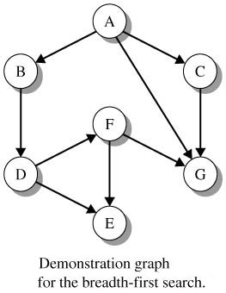
Breadth-First Search Algorithm

Slide 6
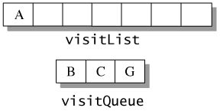
Breadth-First Search Algorithm (continued)
Color all vertices of the sample graph WHITE and push the starting vertex (A) onto the queue visitQueue.
Pop A from the queue, color it BLACK, and insert it into visitList, which is the list of visited vertices. Push all WHITE neighbors onto the queue.

Slide 7
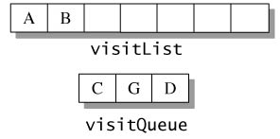
Breadth-First Search Algorithm (continued)
Pop B from the queue and place it in visitList with color BLACK. The only adjacent vertex for B is D, which is still colored WHITE. Color D GRAY and add it to the queue

Slide 8
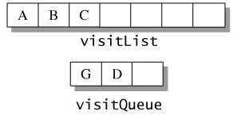
Breadth-First Search Algorithm (continued)
Pop C and place it in visitList. The adjacent vertex G is GRAY. No new vertices enter the queue.

Slide 9
Breadth-First Search Algorithm (continued)
Pop vertex G from the queue and place it in visitList. G has no adjacent vertices, so pop D from the queue. The neighbors, E and F, enter the queue.

Slide 10
Breadth-First Search Algorithm (continued)
Continue in this fashion until the queue is empty.

Slide 11
Implementing Breadth-First Search
Define
public enum VertexColor
{
WHITE, GRAY, BLACK
}

Slide 12
Implementing Breadth-First Search (continued)
The DiGraph class declares three methods that access and update the color attribute of a vertex.

Slide 13
Implementing Breadth-First Search (continued)
The method bfs() returns a list of vertices visited during the breadth‑first search from a starting vertex.

Slide 14
bfs()
// perform the breadth-first traversal
// from sVertex and return the list
// of visited vertices
public static <T> LinkedList<T> bfs(
DiGraph<T> g, T sVertex)
{
// queue stores adjacent vertices; list
// stores visited vertices
LinkedQueue<T> visitQueue = new LinkedQueue<T>();
LinkedList<T> visitList = new LinkedList<T>();
// set and iterator retrieve and scan
// neighbors of a vertex
Set<T> edgeSet;
Iterator<T> edgeIter;
T currVertex = null, neighborVertex = null;

Slide 15
bfs() (continued)
// check that starting vertex is valid
if (!g.containsVertex(sVertex))
throw new IllegalArgumentException(
"bfs(): starting vertex not in the graph");
// color all vertices WHITE
g.colorWhite();
// initialize queue with starting vertex
visitQueue.push(sVertex);
while (!visitQueue.isEmpty())
{
// remove a vertex from the queue, color
// it black, and add to the list of
// visited vertices
currVertex = visitQueue.pop();
g.setColor(currVertex,VertexColor.BLACK);
visitList.add(currVertex);

Slide 16
bfs() (continued)
// obtain the set of neighbors for current vertex
edgeSet = g.getNeighbors(currVertex);
// sequence through the neighbors and look
// for vertices that have not been visited
edgeIter = edgeSet.iterator();
while (edgeIter.hasNext())
{
neighborVertex = edgeIter.next();

Slide 17
bfs() (concluded)
if (g.getColor(neighborVertex) ==
VertexColor.WHITE)
{
// color unvisited vertex GRAY and
// push it onto queue
g.setColor(neighborVertex,VertexColor.GRAY);
visitQueue.push(neighborVertex);
}
}
}
return visitList;
}

Slide 18
bfs() (concluded)
if (g.getColor(neighborVertex) ==
VertexColor.WHITE)
{
// color unvisited vertex GRAY and
// push it onto queue
g.setColor(neighborVertex,VertexColor.GRAY);
visitQueue.push(neighborVertex);
}
}
}
return visitList;
}

Slide 19
Running Time of Breadth-First Search
The running time for the breadth-first search is O(V + E), where V is the number of vertices and E is the number of edges.

Slide 20
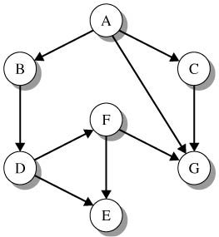
Breadth-First Search Example
// create a graph g and declare startVertex and visitList
DiGraph<String> g = DiGraph.readGraph("bfsgraph.dat");
String startVertex;
List<String> visitList;
...
// call bfs() with arguments g and startVertx
visitList = DiGraphs.bfs(g, startVertex);
// output the visitList
System.out.println("BFS visitList from " + startVertex +
": " + visitList);

Slide 21
Breadth-First Search Example (concluded)
Output:
Run 1: (startVertex = "A")
BFS visitList from A: [A, G, B, C, D, E, F]
Run 2: (startVertex = "D")
BFS visitList from D: [D, E, F, G]
Run 3: (startVertex = "E")
BFS visitList from E: [E]

Slide 22
Depth-First Visit
The depth-first visit algorithm is modeled after the recursive postorder scan of a binary tree. In the tree, a node is visited only after visits are made to all of the nodes in its subtree. In the graph, a node is visited only after visiting all of the nodes in paths that emanate from the node.

Slide 23
Depth-First Visit (continued)
Backtrack to the previous recursive step and look for another adjacent vertex and launch a scan down its paths. There is no ordering among vertices in an adjacency list, so the paths and hence the order of visits to vertices can vary.

Slide 24
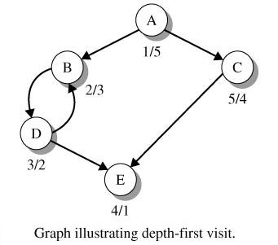
Depth-First Visit (continued)
Discover A (color GRAY)
Discover B (color GRAY)
Discover D (color GRAY)
Discover E (color GRAY, then BLACK)
Backtrack D (color BLACK)
Backtrack B (color BLACK)
Backtrack A (A remains GRAY)
Discover C (color BLACK)
Backtrack A (color BLACK). Visit complete.

Slide 25
Depth-First Visit (continued)
The depth‑first visit is a recursive algorithm that distinguishes the discovery and finishing time (when a vertex becomes BLACK) of a vertex.
The depth‑first visit returns a list of the vertices found in the reverse order of their finishing times.

Slide 26
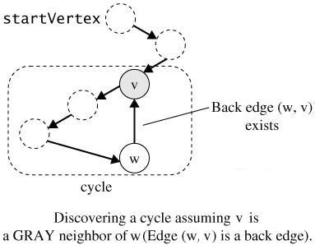
Depth-First Visit (continued)
An edge that connects a vertex to a neighbor that has color GRAY is called a back edge.
A depth-first visit has a cycle if and only if it has a back edge.

Slide 27
dfsVisit()
// depth-first visit assuming a WHITE starting
// vertex; dfsList contains the visited vertices in
// reverse order of finishing time; when checkForCycle
// is true, throws IllegalPathStateException if it
// detects a cycle
public static <T> void dfsVisit(DiGraph<T> g, T sVertex,
LinkedList<T> dfsList, boolean checkForCycle)
{
T neighborVertex;
Set<T> edgeSet;
// iterator to scan the adjacency set of a vertex
Iterator<T> edgeIter;
VertexColor color;
if (!g.containsVertex(sVertex))
throw new IllegalArgumentException(
"dfsVisit(): vertex not in the graph");

Slide 28
dfsVisit() (continued)
// color vertex GRAY to note its discovery
g.setColor(sVertex, VertexColor.GRAY);
edgeSet = g.getNeighbors(sVertex);
// sequence through the adjacency set and look
// for vertices that are not yet discovered
// (colored WHITE); recursively call dfsVisit()
// for each such vertex; if a vertex in the adjacency
// list is GRAY, the vertex was discovered during a
// previous call and there is a cycle that begins and
// ends at the vertex; if checkForCycle is true,
// throw an exception
edgeIter = edgeSet.iterator();

Slide 29
dfsVisit() (concluded)
while (edgeIter.hasNext())
{
neighborVertex = edgeIter.next();
color = g.getColor(neighborVertex);
if (color == VertexColor.WHITE)
dfsVisit(g, neighborVertex, dfsList,
checkForCycle);
else if (color == VertexColor.GRAY && checkForCycle)
throw new IllegalPathStateException(
"dfsVisit(): graph has a cycle");
}
// finished with vertex sVertex; make it BLACK
// and add it to the front of dfsList
g.setColor(sVertex, VertexColor.BLACK);
dfsList.addFirst(sVertex);
}

Slide 30
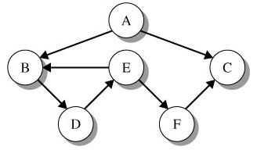
Depth-First Visit Example
LinkedList<String> finishOrder = new LinkedList<String>();
g.colorWhite();
DiGraphs.dfsVisit(g, "B", finishOrder, false);
Output: finishOrder: [B, D, E, F, C]

Slide 31
Depth-First Visit Example (concluded)
finishOrder = new LinkedList<String>();
g.colorWhite();
try
{
DiGraphs.dfsVisit(g, "E", finishOrder, true);
System.out.println("finishOrder: " + finishOrder);
}
catch (IllegalPathStateException ipse)
{
System.out.println(ipse.getMessage());
}
Output: dfsVisit(): cycle involving vertices D and E

Slide 32
Depth-First Search Algorithm
Depth‑first search begins with all WHITE vertices and performs depth‑first visits until all vertices of the graph are BLACK.
The algorithm returns a list of all vertices in the graph in the reverse order of their finishing times.

Slide 33
dfs()
// depth-first search; dfsList contains all
// the graph vertices in the reverse order
// of their finishing times
public static <T> void dfs(DiGraph<T> g,
LinkedList<T> dfsList)
{
Iterator<T> graphIter;
T vertex = null;
// clear dfsList
dfsList.clear();
// initialize all vertices to WHITE
g.colorWhite();

Slide 34
dfs() (concluded)
// call dfsVisit() for each WHITE vertex
graphIter = g.vertexSet().iterator();
while (graphIter.hasNext())
{
vertex = graphIter.next();
if (g.getColor(vertex) == VertexColor.WHITE)
dfsVisit(g, vertex, dfsList, false);
}
}

Slide 35
Running Time for Depth-First Search
An argument similar to that for the breadth-first search shows that that the running time for dfs() is O(V+E), where V is the number of vertices in the graph and E is the number of edges.

Slide 36
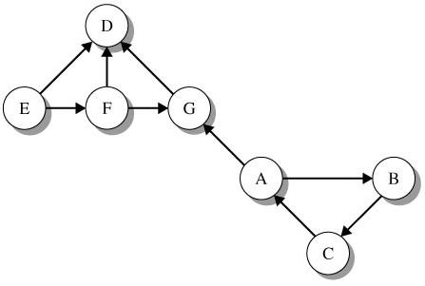
Depth-First Search Example
dfsVisit() starting at E followed by dfsVisit() starting at A
dfsList: [A, B, C, E, F, G, D]

Slide 37
Program 24.2
import java.io.FileNotFoundException;
import ds.util.DiGraph;
import ds.util.DiGraphs;
public class Program24_2
{
public static void main(String[] args)
throws FileNotFoundException
{
DiGraph<String> g = DiGraph.readGraph("cycle.dat");
// determine if the graph is acyclic
if (DiGraphs.acyclic(g))
System.out.println("Graph is acyclic");
else
System.out.println("Graph is not acyclic");

Slide 38
Program 24.2 (concluded)
// add edge (E,B) to create a cycle
System.out.print(" Adding edge (E,B): ");
g.addEdge("E", "B", 1);
// retest the graph to see if it is acyclic
if (DiGraphs.acyclic(g))
System.out.println("New graph is acyclic");
else
System.out.println("New graph is not acyclic");
}
}
Run:
Graph is acyclic
Adding edge (E,B): New graph is not acyclic

