Slide 1
Graph

Slide 2
Terminologi Graph
A graph consists of a set of vertices V, along with a set of edges E that connect pairs of vertices.
An edge e = (vi,vj) connects vertices vi and vj.
A self-loop is an edge that connects a vertex to itself. We assume that none of our graphs have self-loops.
Vertices = {v₁, v₂, v₃, …, v_{m}}
Edges = {e₁, e₂, e₃, …, _{en}}

Slide 3
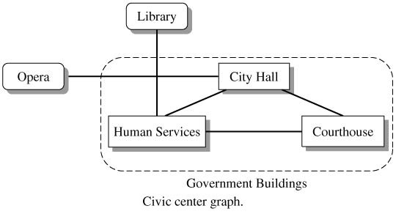
Graph Terminology (continued)

Slide 4
Graph Terminology (continued)
The degree of a vertex is the number of edges originating at the vertex.
Two vertices in a graph are adjacent (neighbors) if there is an edge connecting the vertices.
A path between vertices v and w is a series of edges leading from v to w. The path length is the number of edges in the path.

Slide 5
Graph Terminology (continued)
A path is simple if all its edges are distinct. A cycle is a simple path that starts and ends on the same vertex.
A graph is connected if there is a path between any pair of distinct vertices.
A complete graph is a connected graph in which each pair of vertices is linked by an edge.

Slide 6
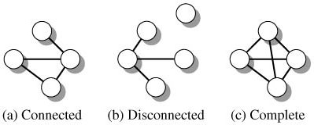
Graph Terminology (continued)

Slide 7
Graph Terminology (continued)
A graph described until now is termed an undirected graph. Movement between vertices can occur in either direction.
In a digraph, edges have a direction. There might be an edge from v to w but no edge from w to v.

Slide 8
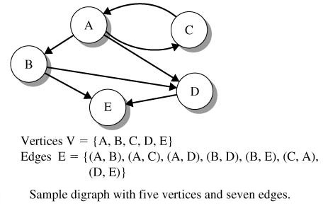
Graph Terminology (continued)

Slide 9
Graph Terminology (continued)
In a digraph, a directed path (path) connecting vertices v_{s} and v_{e} is a sequence of directed edges that begin at v_{s} and end at v_{e}.
The number of the edges that emanate from a vertex v is called the out-degree of the vertex.
The number of the edges that terminate in vertex v is the in-degree of the vertex.

Slide 10
Graph Terminology (continued)
A digraph is strongly connected if there is a path from any vertex to any other vertex.
The digraph is weakly connected if, for each pair of vertices v_{i} and v_{j}, there is either a path P(v_{i}, v_{j}) or a path P(v_{j},v_{i}).

Slide 11
Graph Terminology (continued)

Slide 12
Graph Terminology (concluded)
An acyclic graph has no cycles.
Each edge in a weighted digraph, has a cost associated with traversing the edge.

Slide 13
Creating and Using Graphs
The Graph interface specifies all basic graph operations including inserting and erasing vertices and edges.

Slide 14
Creating and Using Graphs (continued)

Slide 15
Creating and Using Graphs (continued)

Slide 16
Creating and Using Graphs (continued)

Slide 17
Creating and Using Graphs (continued)

Slide 18
Creating and Using Graphs (continued)

Slide 19
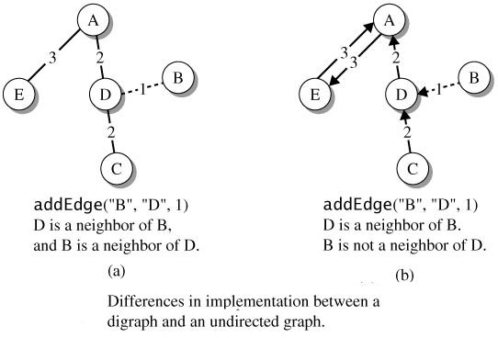
Creating and Using Graphs (continued)

Slide 20
The DiGraph Class
The DiGraph class implements the Graph interface and adds other methods that are useful in applications.
A constructor creates an empty graph.
The methods inDegree() and outDegree() are special methods that access a properties that are unique to a digraph.
The static method readGraph() builds a graph whose vertices are strings.

Slide 21
The DiGraph Class (continued)
DiGraph method readGraph() inputs the vertex values and the edges from a textfile.
File format:
(Number of Edges n)
Source₁ Destination₁ Weight₁
Source₂ Destination₂ Weight₂
. . .
Source_{n} Destination_{n} Weight_{n}

Slide 22
The DiGraph Class (continued)
The method toString() provides a representation of a graph. For each vertex, the string gives the list of adjacent vertices along with the weight for the corresponding edge. The information for each vertex also includes its in-degree and out-degree.

Slide 23
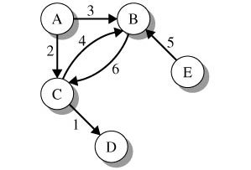
The DiGraph Class (continued)
File samplegraph.dat
5 // data for the vertices
A B C D E
6 // data for the edges
A B 3
A C 2
B C 6
C B 4
C D 1
E B 5
// input vertices, edges, and weights from samplegraph.dat
DiGraph g = DiGraph.readGraph("samplegraph.dat");
// display the graph
System.out.println(g)

Slide 24
The DiGraph Class (continued)
Output:
A: in-degree 0 out-degree 2
Edges: B(3) C(2)
B: in-degree 3 out-degree 1
Edges: C(6)
C: in-degree 2 out-degree 2
Edges: B(4) D(1)
D: in-degree 1 out-degree 0
Edges:
E: in-degree 0 out-degree 1
Edges: B(5)

Slide 25
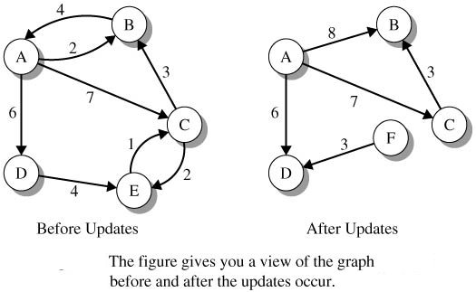
Program 24.1

Slide 26
Program 24.1 (continued)
import java.io.FileNotFoundException;
import ds.util.Set;
import ds.util.Iterator;
import ds.util.DiGraph;
public class Program24_1
{
public static void main(String[] args)
throws FileNotFoundException
{
// construct graph with vertices of type
// String by reading from the file "graphIO.dat"
DiGraph<String> g =
DiGraph.readGraph("graphIO.dat");
String vtxName;
// sets for vertexSet() and adjacent
// vertices (neighbors)
Set<String> vtxSet, neighborSet;

Slide 27
Program 24.1 (continued)
// output number of vertices and edges
System.out.println("Number of vertices: " +
g.numberOfVertices());
System.out.println("Number of edges: " +
g.numberOfEdges());
// properties relative to vertex A
System.out.println("inDegree for A: " +
g.inDegree("A"));
System.out.println("outDegree for A: " +
g.outDegree("A"));
System.out.println("Weight e(A,B): " +
g.getWeight("A","B"));
// delete edge with weight 2
g.removeEdge("B", "A");
// delete vertex "E" and edges (E,C),
// (C,E) and (D,E)
g.removeVertex("E");

Slide 28
Program 24.1 (continued)
/* add and update attributes of the graph */
// increase weight from 4 to 8
g.setWeight("A","B",8);
// add vertex F
g.addVertex("F");
// add edge (F,D) with weight 3
g.addEdge("F","D",3);
// after all updates, output the graph
// and its properties
System.out.println("After all the graph updates");
System.out.println(g);
// get the vertices as a Set and
// create set iterator
vtxSet = g.vertexSet();
Iterator vtxIter = vtxSet.iterator();

Slide 29
Program 24.1 (concluded)
// scan the vertices and display
// the set of neighbors
while(vtxIter.hasNext())
{
vtxName = (String)vtxIter.next();
neighborSet = g.getNeighbors(vtxName);
System.out.println(" Neighbor set for " +
"vertex " + vtxName + " is "
+ neighborSet);
}
}
}

