Slide 1
Praktikum Kecerdasan Buatan
Artificial Neural Network
Department of Information and Computer Engineering
Politeknik Elektronika Negeri Surabaya

Slide 2
Konten
Review Artificial Neural Network
Aplikasi Artificial Neural Network

Slide 3
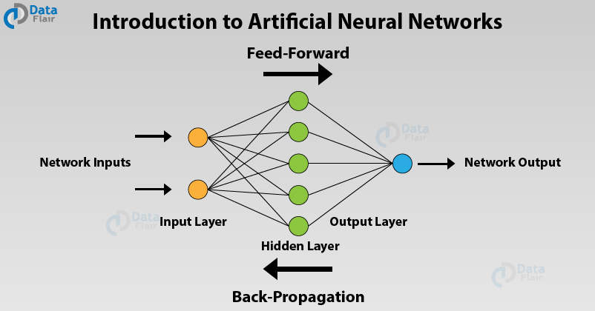

Slide 4
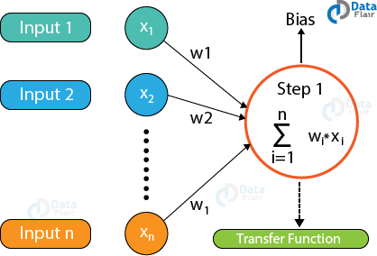
Artificial Neural Networks Architecture
Input Layers
The input layer is the first layer of an ANN that receives the input information in the form of various texts, numbers, audio files, image pixels, etc.
Hidden Layers
In the middle of the ANN model are the hidden layers.
There can be a single hidden layer, as in the case of a perceptron or multiple hidden layers.
These hidden layers perform various types of mathematical computation on the input data and recognize the patterns that are part of.
Output Layer
In the output layer, we obtain the result that we obtain through rigorous computations performed by the middle layer.
https://data-flair.training/blogs/artificial-neural-networks-for-machine-learning/

Slide 5
Parameters and hyperparameters
In a neural network, there are multiple parameters and hyperparameters that affect the performance of the model.
The output of ANNs is mostly dependent on these parameters.
Some of these parameters are:
  weights,
  biases,
  learning rate,
  batch size etc.
Each node in the network has some weights assigned to it.

Slide 6
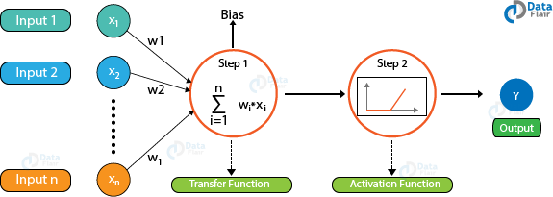
Activation functions
A transfer function is used for calculating the weighted sum of the inputs and the bias.
After the transfer function has calculated the sum, the activation function obtains the result.
Based on the output received, the activation functions fire the appropriate result from the node.
For example, if the output received is above 0.5, the activation function fires a 1 otherwise it remains 0.
Some of the popular activation functions used in Artificial Neural Networks are Sigmoid, RELU, Softmax, tanh etc.
https://data-flair.training/blogs/artificial-neural-networks-for-machine-learning/

Slide 7
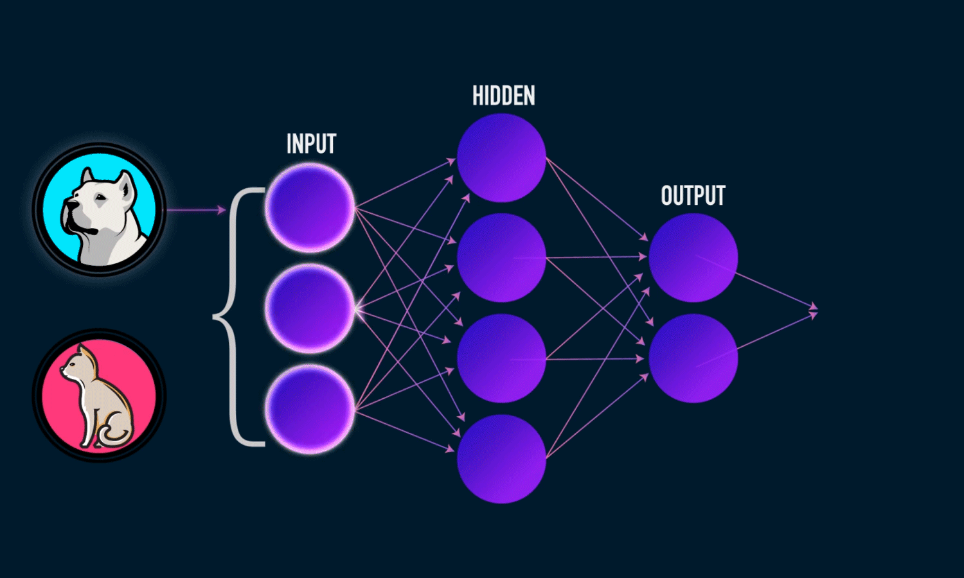
Error Functions
Based on the value that the node has fired, we obtain the final output.
Then, using the error functions, we calculate the discrepancies between the predicted output and resulting output and adjust the weights of the neural network through a process known as backpropagation.

Slide 8
Back Propagation in Artificial Neural Networks
In order to train a neural network, we provide it with examples of input-output mappings.
Finally, when the neural network completes the training, we test the neural network where we do not provide it with these mappings.
The neural network predicts the output and we evaluate how correct the output is using the various error functions.
Finally, based on the result, the model adjusts the weights of the neural networks to optimize the network following gradient descent through the chain rule.

Slide 9
Types of Artificial Neural Networks
There are two important types of Artificial Neural Networks
  FeedForward Neural Network
  FeedBack Neural Network

Slide 10
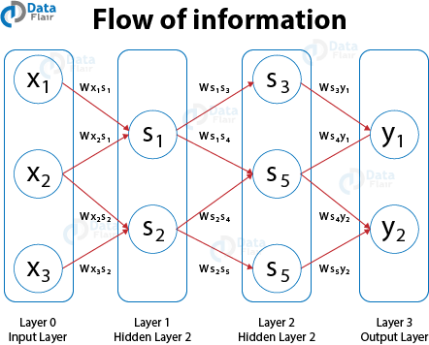
FeedForward Artificial Neural Networks
In the feedforward ANNs, the flow of information takes place only in one direction.
That is, the flow of information is from the input layer to the hidden layer and finally to the output.
There are no feedback loops present in this neural network.
These type of neural networks are mostly used in supervised learning for instances such as classification, image recognition etc.
We use them in cases where the data is not sequential in nature.

Slide 11
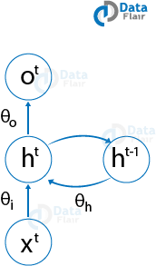
Feedback Artificial Neural Networks
In the feedback ANNs, the feedback loops are a part of it.
Such type of neural networks are mainly for memory retention such as in the case of recurrent neural networks.
These types of networks are most suited for areas where the data is sequential or time-dependent.

Slide 12
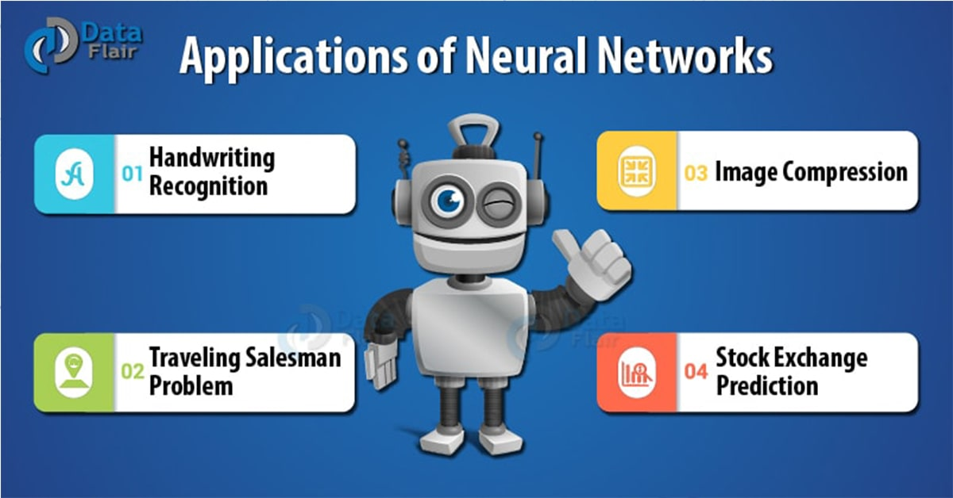
Artificial Neural Networks Applications

Slide 13
Artificial Neural Networks Applications
Handwritten Character Recognition
Speech Recognition
Signature Classification
Facial Recognition

Slide 14
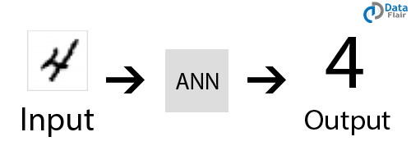
Handwritten Character Recognition
ANNs are used for handwritten character recognition.
Neural Networks are trained to recognize the handwritten characters which can be in the form of letters or digits.
The bitmap pattern of the handwritten character is input, with the correct letter or digit as the desired output.
Such programs need the user to train the network by providing the program with their handwritten patterns.

Slide 15
Handwritten Character Recognition
The two common applications of handwriting recognition are:
  Optical character recognition for data entry
  Validation of signatures on a bank cheque

Slide 16
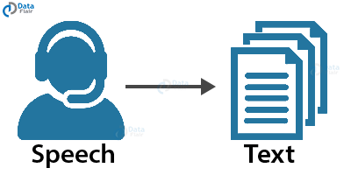
Speech Recognition
ANNs play an important role in speech recognition.
The earlier models of Speech Recognition were based on statistical models like Hidden Markov Models.
With the advent of deep learning, various types of neural networks are the absolute choice for obtaining an accurate classification.

Slide 17
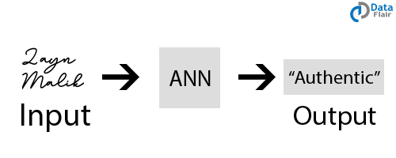
Signature Classification
For recognizing signatures and categorizing them to the person’s class, we use artificial neural networks for building these systems for authentication.
Furthermore, neural networks can also classify if the signature is fake or not.

Slide 18
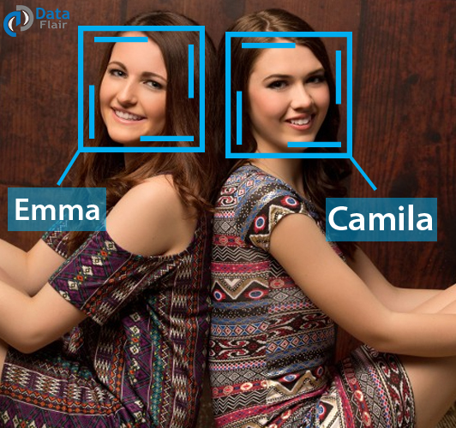
Facial Recognition
In order to recognize the faces based on the identity of the person, we make use of neural networks.
They are most commonly used in areas where the users require security access.
Convolutional Neural Networks are the most popular type of ANN used in this field.

Slide 19
Referensi
Artificial Neural Networks for Machine Learning – Every aspect you need to know about, https://data-flair.training/blogs/artificial-neural-networks-for-machine-learning/

Slide 20
Tugas
[25-29] Simple Neural Networks in Python,
  Aidan Wilson, 2019
  https://towardsdatascience.com/inroduction-to-neural-networks-in-python-7e0b422e6c24
[21-24] How to build your own Neural Network from scratch in Python
  James Loy. 2018
  A beginner’s guide to understanding the inner workings of Deep Learning
  https://towardsdatascience.com/how-to-build-your-own-neural-network-from-scratch-in-python-68998a08e4f6
[17-20] How to create a simple neural network in Python
  Dr. Michael J. Garbade, 2019
  https://www.kdnuggets.com/2018/10/simple-neural-network-python.html

Slide 21
Tugas
[13-16] Neural Networks from Scratch with Python Code and Math in Detail— I
  Building neural networks from scratch. From the math behind them to step-by-step implementation coding samples in Python with Google Colab
  Towards AI Team Towards AI Team Follow, Jun 20, 2020
  https://pub.towardsai.net/building-neural-networks-from-scratch-with-python-code-and-math-in-detail-i-536fae5d7bbf
[9-12] Neural Networks are Function Approximation Algorithms
  Jason Brownlee, 2020
  https://machinelearningmastery.com/neural-networks-are-function-approximators/
  [5-8] Develop a Neural Network for Cancer Survival Dataset
  Jason Brownlee, 2021
  https://machinelearningmastery.com/neural-network-for-cancer-survival-dataset/
  [1-4] Python AI: How to Build a Neural Network & Make Predictions
  Déborah Mesquita Mar 17, 2021
  https://realpython.com/python-ai-neural-network/\

Slide 22
Referensi
Artificial Neural Networks for Machine Learning – Every aspect you need to know about, https://data-flair.training/blogs/artificial-neural-networks-for-machine-learning/

