Slide 1
Contoh Soal Fuzzy

Slide 2
Exercise
The problem is to estimate the level of risk involved in a software engineering project. For the sake of simplicity we will arrive at our conclusion based on two inputs: project funding and project staffing.

Slide 3
Step 1
The first step to convert the crisp input into a fuzzy one. Since we have two inputs we will have 2 crisp values to convert. The first value the level of project staffing. The second value is the level of project funding.
Suppose our our inputs are project_funding = 35% and project_staffing = 60%. We can an get the fuzzy values for these crisp values by using the membership functions of the appropriate sets. The sets defined for project_funding are inadequate, marginal and adequate. The sets defined for project_staffing are small and large.

Slide 4
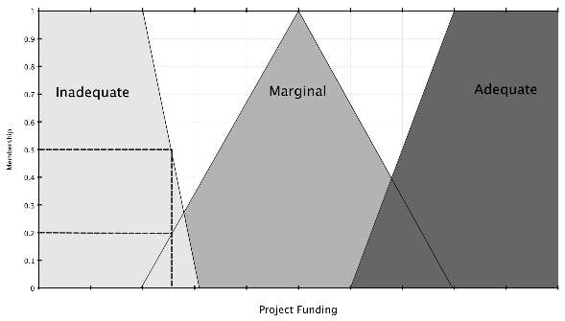
Step 1
Thus we have the following fuzzy values for project_funding:
μ funding=inadequate(35)=0.5
μ funding=marginal(35)=0.2
μ funding=adequate(35)=0.0

Slide 5
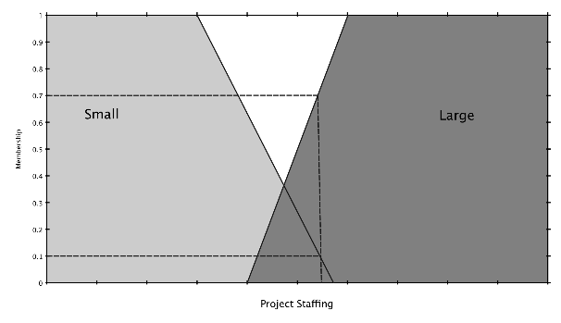
Step 1
The fuzzy values for project_staffing are shown below.
μ staffing=small(60)=0.1
μ staffing=large(60)=0.7

Slide 6
The Rules
Now that we have the fuzzy values we can use the fuzzy rules to arrive at the final fuzzy value. The rules are as follows:
  If project_funding is adequate or project_staffing is small then risk is low.
  If project_funding is marginal and project_staffing is large then risk is normal.
  If project_funding is inadequate then risk is high.

Slide 7
Rule 1 - If project_funding is adequate or project_staffing is small then risk is low
Rules containing disjunctions, OR, are evaluated using the UNION operator.
μ A∪B(x)=max[μ A(x),μB(x)]
μrisk=low=max[μfunding=adequate(35),μstaffing=small(60)]=max[0.0,0.1]=0.1

Slide 8
Rule 2 - If project_funding is marginal and project_staffing is large then risk is normal
Conjunctions in fuzzy rules are evaluated using the INTERSECTION operator.
μA∩B(x)=min[μA(x),μB(x)]
μrisk=normal=max[μfunding=marginal(35),
μstaffing=large(60)]=max[0.2,0.7]=0.2

Slide 9
Rule 3 - If project_funding is inadequate then risk is high
μrisk=high = 0.5

Slide 10
Rule Evaluation Results
The result of evaluating the rules is shown below:
μ risk=low(z)=0.1
μ risk=normal(z)=0.2
μ risk=high(z)=0.5

Slide 11
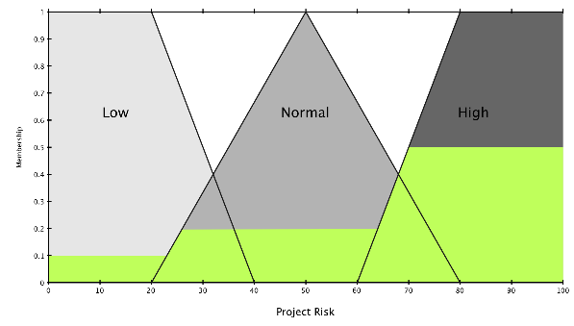
Rule Evaluation Results

Slide 12
Defuzzification
Largest value of maximum
  Assuming there is a plateau at the maximum value of the final function take the largest of the values it spans.
μ risk=low(z)=0.1
μ risk=normal(z)=0.2
μ risk=high(z)=0.5 → Max

Slide 13

Defuzzification
Centroid method
  Calculates the center of gravity for the area under the curve.
  The result is that this project has 67.4% risk associated with it given the definitions above.

