Slide 1
Recommender System

Slide 2







Introduction to Recommender System
Various Items
Recommended Items
Recommender System

Slide 3
Why recommender system?
1
Better customer journey
2
Customer satisfaction
3
Gain more revenue

Slide 4
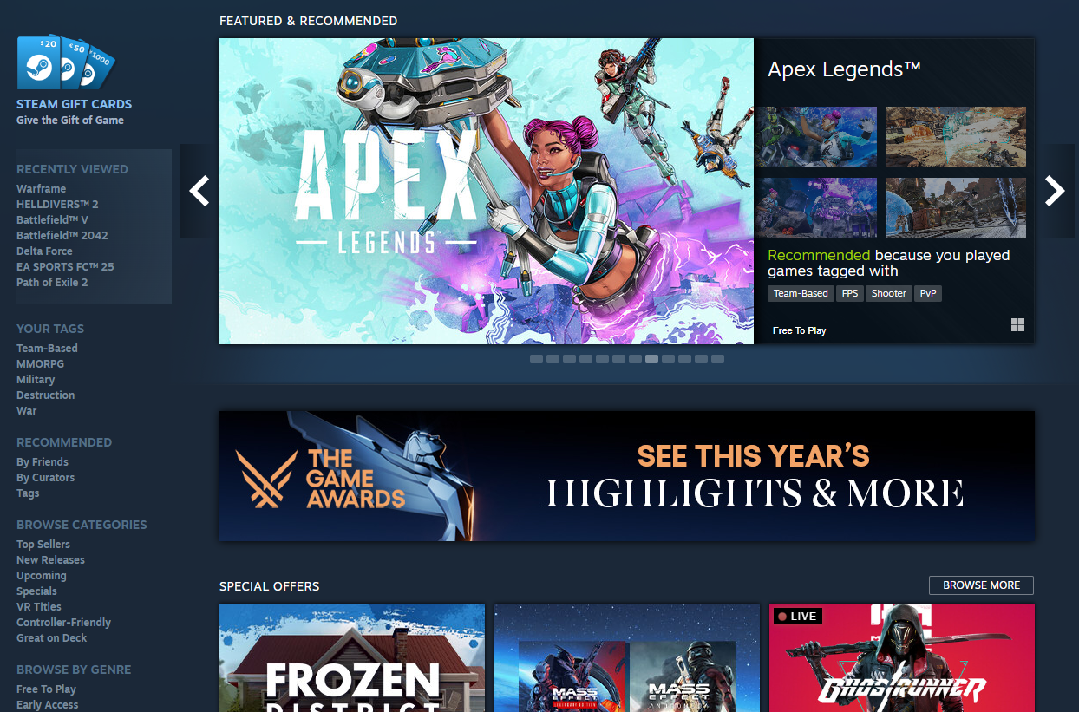
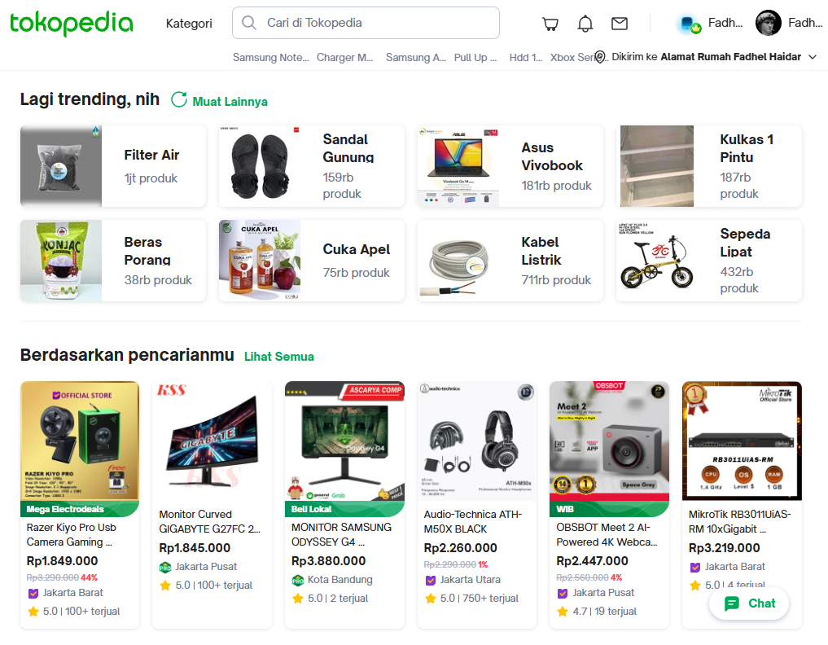
Implementation in real life

Slide 5
Types of Recommender system
Non-personalized recommender system
Personalized recommender system

Slide 6
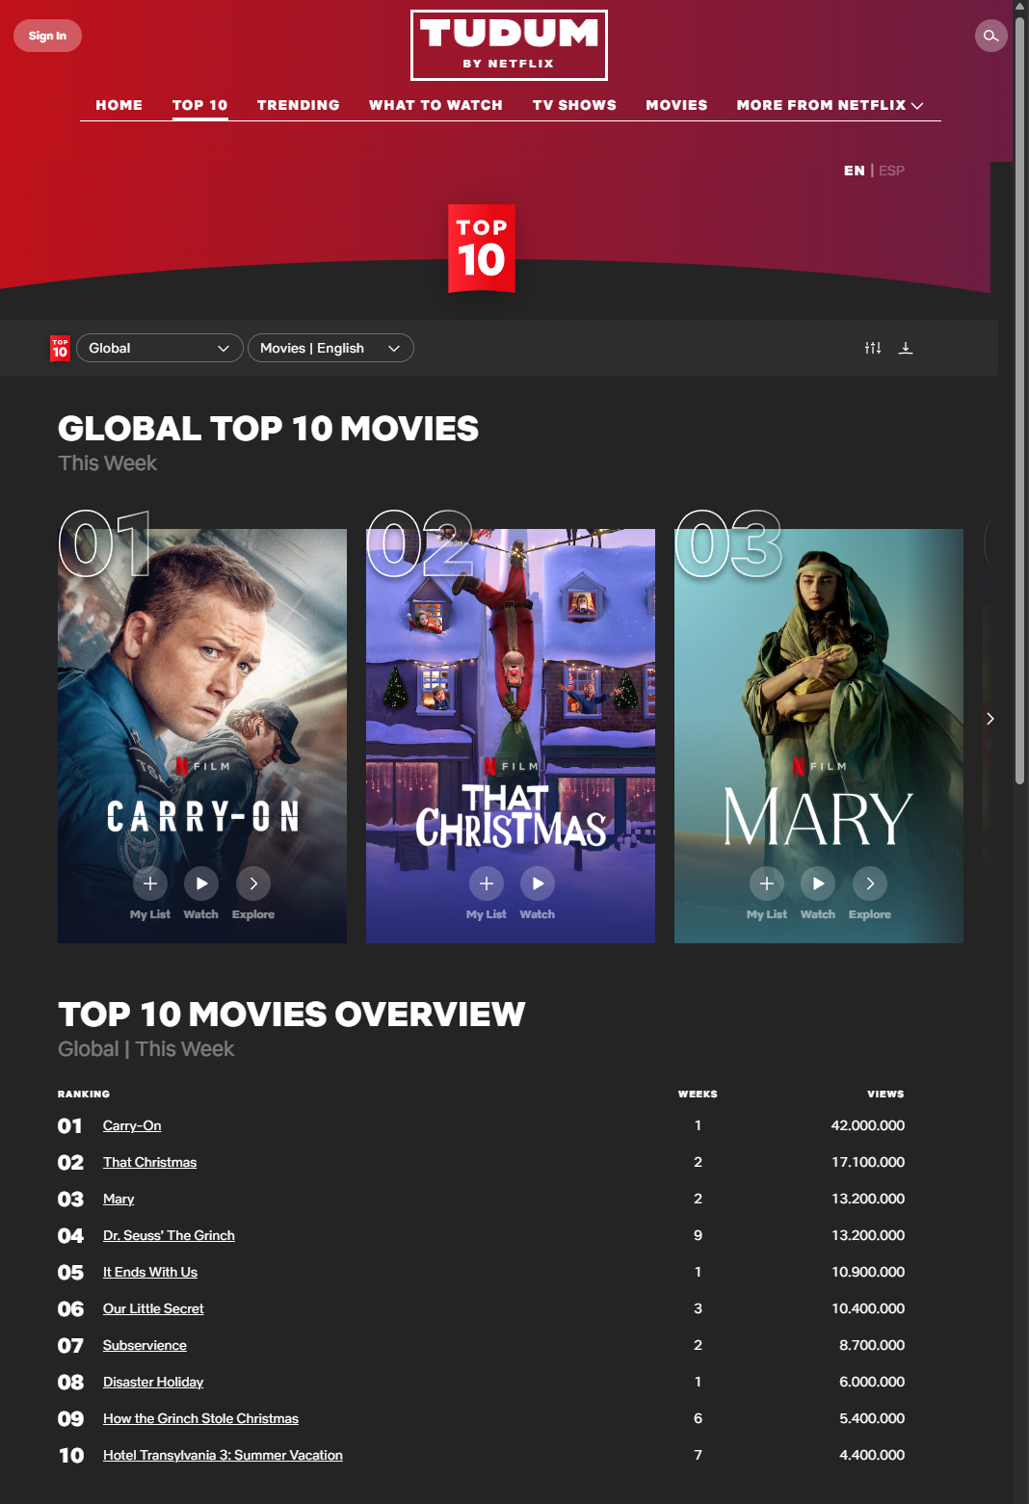
Non-personalized
System
recommendation based on Rating

Slide 7
Personalized
System
User 1
User 2
Preference : Action, Sci-Fi, Crime
Preference : Drama, Romance, Comedy
Movie Recommendation :
John Wick
Start Wars
Dune
Movie Recommendation :
The Vow
La La Land
To All the Boys I've Loved Before

Slide 8
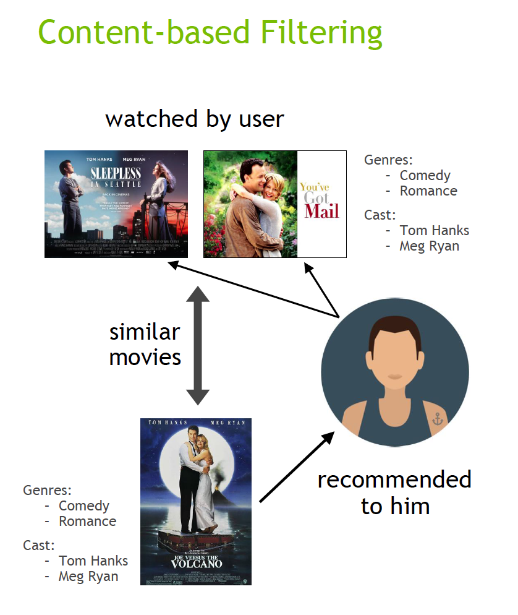
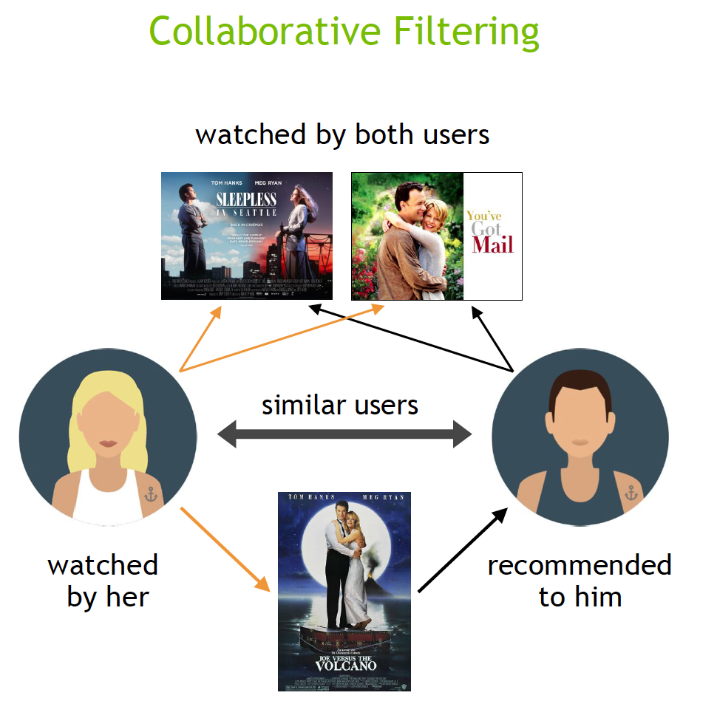
Personalized System Approach

Slide 9
Recommender System Workflow
Determine customer preference
1. Using questionnaires to directly elicit preferences.
2. Employing proxy labels (e.g., ratings, likes/dislikes, checkouts) as indirect indicators of preference.
Methodologies Framing
Data gathering
1. Explicit Rating : User directly tell labeling the data (e.g., Rating, likes/dislikes)
2. Implicit Rating : User Activity (e.g., Checkout, Listening Hours, Views)

Slide 10
When recommending items to users, we need to:
Analyze their historical preferences and
interactions Identify patterns in their behavior
Find similar items that match their taste profile
Similarity Measure
How to calculate similarities between data?

Slide 11
Similarity Measure Illustration
How to determine similarity?
Movie A
Genre :
Horror
Thriller
Mystery
Movie B
Genre :
Horror
Thriller
Use item feature
determine item features (e.g., Movies genre, Item Rating, Game Genre, etc)
Check if the features have something in common between them or not
Movies are similar because they have 2 genre in common

Slide 12
What if the data have high dimension feature?
Jaccard Similarities
Euclidean Distance
Cosine Similarities

Slide 13
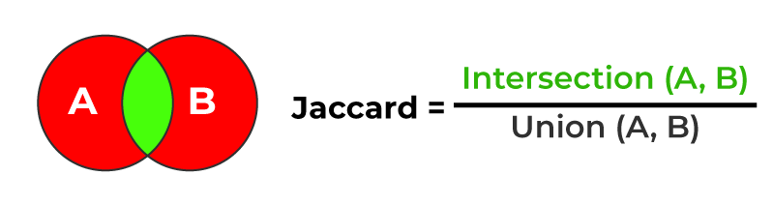
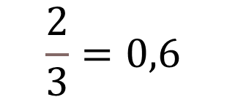
Jaccard Similarities
Movie A
Genre :
Horror
Thriller
Mystery
Movie B
Genre :
Horror
Thriller
Genre | Movie A | Movie B | Genre A = B?
Horror | 1 | 1 | 1
Thriller | 1 | 1 | 1
Mystery | 1 | 0 | 0
$$\frac{2}{3}=0,6$$
If we set the similarity threshold as 0.5, both movies considered similar because the similarity value is 0.6

Slide 14
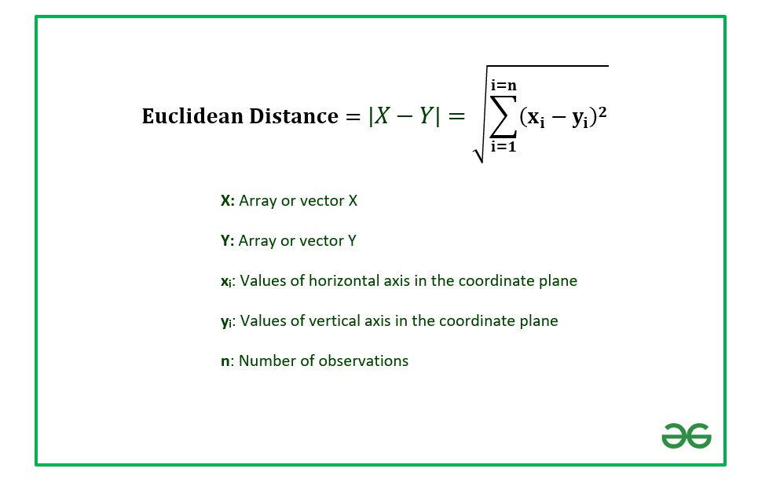
Euclidean Distance
Example case
User need a hall for an event, the requirement is
Capacity of 1000 person more of less
Parking capacity for 300 car more or less
User requirement
Hall A
Hall A
1200 Perso
500 car
Hall B
2000 Perso
900 car
Hall B
Person
Capacity
The Distance
2000
1200
1000
The Distance
300
500
900
Parking Capacity

Slide 15


Euclidean Distance
Distance calculation for 2D
Distance requirement towards Hall A
For Hall A:
Difference in Length, Length as X, X2 – X1 = 1200 - 1000 = 200
Difference in Width, Width as Y, Y2 – Y1 = 500 - 300 = 200
Euclidean Distance = √((200)^2 + (200)^2) = √(40000 + 40000) = √80000 = 282.8427
For Hall B:
Difference in Length = 2000 - 1000 = 1000
Difference in Width = 900 - 300 = 600
Euclidean Distance = √((1000)^2 + (600)^2) = √(1000000 + 360000) = √1360000 = 1166.274
$$ⅆA<ⅆB$$
Distance A is shorter than distance B, so Hall A is likely preferred by User

Slide 16
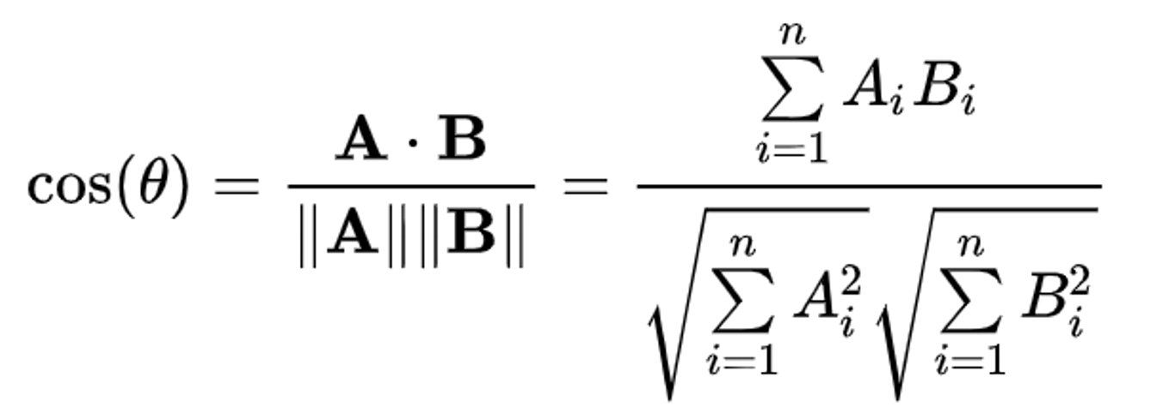
Cosine Similarity
Example case
User need a hall for an event, the requirement is
Capacity of 1000 person more of less
Parking capacity for 300 car more or less
User requirement
Hall A
Hall A
1200 Perso
500 car
Hall B
2000 Perso
900 car
Hall B
Person
Capacity
2000
The cosine value from the angle
1200
1000
300
500
900
Parking Capacity

Slide 17
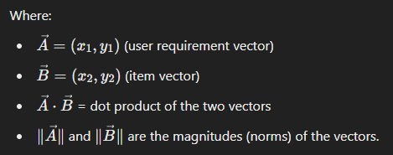

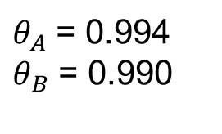
Cosine Similarity
Distance calculation for 2D
For Item A:
Dot product of User's requirement and Item A = (1000*1200) + (300*500) = 1200000 + 150000 = 1350000
Magnitude of User's requirement vector = √((1000)^2+(300)^2) = 1000000 + 90000 = 1090000 ≈ 1043.86
Magnitude of Item A vector = √((1200)^2+(500)^2) = 1440000 + 250000 = 1690000 ≈ 1300.00
Cosine Similarity = 1350000 / (1043.86×1300.00) ≈ 1350000/1357318 ≈ 0.994
For Item B:
Dot product of User's requirement and Item B = (1000*2000) + (300*900) = 2000000 + 270000 = 2270000
Magnitude of User's requirement vector (already calculated) ≈1043.86
Magnitude of Item B vector = √((2000)2+(900)2) = 4000000 + 810000 = 4810000 ≈ 2193.23
Cosine Similarity = 2270000/(1043.86×2193.23) ≈ 2270000/2293123 ≈ 0.990
$θ_{A}$ = 0.994
$θ_{B}$ = 0.990
-1
0
1
$θ$ Scale
Cos value of item A is closer to 1 which mean the vector of User requirements to item A is

Slide 18
Now let’s get to the recommender system
(Content Based Filtering)

Slide 19


Content Based Filtering
Features
Genre : Action, Sci-Fi
Keywords : Dreams, Heist, Mind-bending
Extract Features
Item List/Catalog
Calculate Similarities
Get Similar Item based on Top N
Recommend To User

Slide 20
Content Based Filtering
User A have no idea about which movies, based on the watch history, he just watched Inception, in front of him now listed multiple movies, help him to chose one movie that suit his taste
Movie | Genres | Keywords
Inception | Action, Sci-Fi | Dreams, Heist, Mind-bending
Interstellar | Adventure, Sci-Fi | Space, Exploration
The Dark Knight | Action, Crime | Vigilante, Hero,
The Matrix | Action, Sci-Fi | Simulation, Reality
Shutter Island | Mystery, Thriller | Mental Institution, Psychological

Slide 21
Content Based Filtering
Features Vectorization
Convert all the feature into numerical form.
To achieve this, various vectorization method can be used such as one-hot encoding, TF-IDF, Count Vectorization. For this case use one-hot as the simple
Movie | Sci-Fi | Action | Adventure | Crime | Mystery | Thriller | Dreams | Heist | Mind-bending | Space | Exploration | Vigilante | Hero | Joker | Simulation | Reality | Institution | Psychological
Inception | 1 | 1 | 0 | 0 | 0 | 0 | 1 | 1 | 1 | 0 | 0 | 0 | 0 | 0 | 0 | 0 | 0 | 0
Interstellar | 1 | 0 | 1 | 0 | 0 | 0 | 0 | 0 | 0 | 1 | 1 | 0 | 0 | 0 | 0 | 0 | 0 | 0
The Dark Knight | 0 | 1 | 0 | 1 | 0 | 0 | 0 | 0 | 0 | 0 | 0 | 1 | 1 | 1 | 0 | 0 | 0 | 0
The Matrix | 1 | 1 | 0 | 0 | 0 | 0 | 0 | 0 | 0 | 0 | 0 | 0 | 0 | 0 | 1 | 1 | 0 | 0
Shutter Island | 0 | 0 | 0 | 0 | 1 | 1 | 0 | 0 | 0 | 0 | 0 | 0 | 0 | 0 | 0 | 0 | 1 | 1

Slide 22
Content Based Filtering
Calculate the inception movie vector with other data
Example Calculation: Similarity between Inception and Interstellar
Feature vectors:
Inception: [1,1,0,0,0,0,1,1,1,0,0,0,0,0,0,0,0,0,0]
Interstellar: [0,1,1,0,0,0,0,0,0,1,1,0,0,0,0,0,0,0,0]
Dot product:
𝐴⋅𝐵=(1×0)+(1×1)+(0×1)+…=1A⋅B=(1×0)+(1×1)+(0×1)+…=1
Magnitude of vectors:
||A|| = √(1^2 + 1^2 + 0^2 +...) = √4 = 2
||B|| = √(0^2 + 1^2 + 1^2 +...) = √3
Cosine Similarity
Similarity(A, B) = (A ⋅ B) / (||A|| × ||B||) = 1 / (2 × √3) ≈ 0.29

Slide 23
Content Based Filtering
Result
After apply the calculation between inception and another data, we got this
Cosine Similarities with Inception:
Interstellar 0.223607
The Dark Knight 0.200000
The Matrix 0.447214
Shutter Island 0.000000
Based on the result, The Matrix has the closest number to 1, we can conclude that The matrix will be the movies to watch next.

Slide 24
Now let’s get to the recommender system
(Collaborative Filtering)

Slide 25
Collaborative Filtering
Content Based much likely to recommend item less diverse, at some point user want more diverse recommendation
User 1
Rating On Movies :
Inception 5
Interstellar 4
The Dark Knight 3
The Vow 2
Shutter Island 3
User 2
Rating On Movies :
Inception 2
Interstellar 2
The Dark Knight 2
The Vow 5
Shutter Island 1
User 3
Rating On Movies :
Inception ?
Interstellar 5
The Dark Knight 4
The Vow 2
Shutter Island 3
Inception is recommended for User 3 based on similar behavior to User 1.

Slide 26
Collaborative Filtering
To calculate the similarities between user and predict the rating of the recommended movies to user, we will utilize Neighborhood Collaborative Filtering, it’s actually has the same approach with KNN.
The approach can be divided to
User to user
Item to Item

Slide 27
Collaborative Filtering
Given a data like this from streaming service, they want to recommend Movie C to Budi, so to know whether Budi likes Movie C or not, we need to calculate another user that has similar behavior with Budi and predict the Budi’s rating for Movie C .
User | Movie A | Movie B | Movie C | Movie D
Budi | 5 | 4 | ? | 1
Joko | 4 | 5 | 3 | 1
Raka | 1 | 2 | 5 | 2
Bowo | 4 | 5 | 2 | 1

Slide 28
Collaborative Filtering
Calculate the similarities between Budi and other user
User | User’s similarity with Budi
Joko | 0.885878
Raka | 0.396942
Bowo | 0.932782

Slide 29
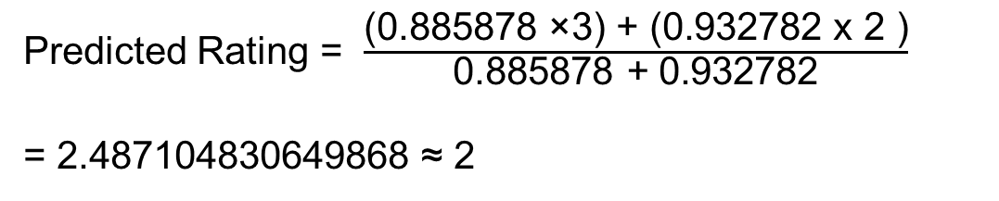
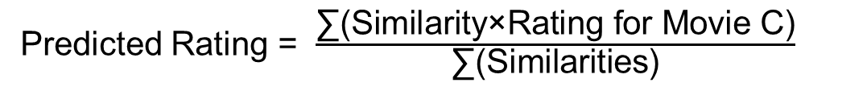
Collaborative Filtering
Predict the movie rating
User | User’s similarity with Budi
Joko | 0.885878
Raka | 0.396942
Bowo | 0.932782
User | User’s similarity with Budi
Joko | 0.885878
Bowo | 0.932782
Top K = 2
Predicted Rating = $\frac{\text{∑(}\text{Similarity}\text{×}\text{Rating} \text{for} \text{Movie} \text{C}\text{)}}{\text{∑(}\text{Similarities}\text{)}}$
Predicted Rating = $\frac{\text{(}\text{0.885878 }\text{×}\text{3}\text{)}\text{ + (}\text{0.932782 }\text{x}\text{ 2 )}}{\text{0.885878}\text{ + }\text{0.932782}}$
= 2.487104830649868 ≈ 2
After that, if the threshold for movie recommendation is 3, we can conclude that the movie is not recommended, then move on to another items

Slide 30
Thank you

