Slide 1
Android Selection Widgets
Yuliana Setiowati
Rizky Yuniar Hakkun

Slide 2
Outline
ListView
Spinner
AutoCompleteTextView
Gallery View
GridView

Slide 3
Selection Widgets
RadioButtons and CheckButtons are suitable for selecting from a smallset of options.
When the pool of choices is larger other widgets are more appropriate, those include classic UI controls such as:listboxes, comboboxes, drop-down lists, picture galleries, etc.
Android offers a framework of data adapters that provide a common interface to selection lists ranging from static arrays to database contents.
Selection views –widgets for presenting lists of choices –are handed an adapter to supply the actual choices.

Slide 4
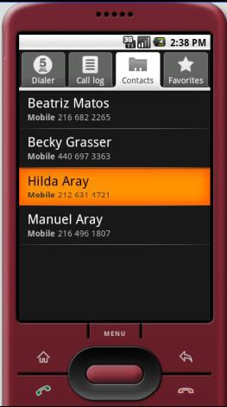
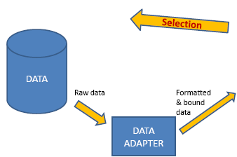
Selection Widgets
Displaying/Selecting Options
Destination layout
Holding a ListView

Slide 5
Using ArrayAdapter
The easiest adapter to use is ArrayAdapter
The ArrayAdapter constructor takes three parameters:
1.The Context to use (typically this will be your activity instance)
2.The resource ID of a view to use (such as the built-in system resource android.R.layout.simple_list_item_1as shown above)
3.The actual (source) array or list of items to show
String[] items={"this", "is", "a","really", "silly", "list"};
new ArrayAdapter<String>
(this,android.R.layout.simple_list_item_1,items);

Slide 6
Selection Widgets List Views
The ListView view displays a list of items in a vertically scrolling list

Slide 7
Selection Widgets
1.In the XML layout we use a ListView widget called android:id/list (built-in definition using multiple lines, black background, light-gray separator line, horiz. scroll-bar)
2. Later in the setting of the ArrayAdapter we make a reference to android.R.layout.simple_list_item_1(details representation of a single entry in the list)

Slide 8
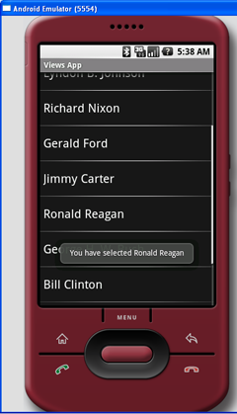
Selection Widgets Example 1
Example 1: A simple list
When an item is selected, a message will be displayed.

Slide 9
Selection Widgets Example 1
Example 1: A simple list
listview.xml
<?xml version="1.0" encoding="utf-8"?>
<LinearLayout xmlns:android="http://schemas.android.com/apk/res/android"
android:orientation="vertical"
android:layout_width="fill_parent"
android:layout_height="fill_parent"
>
<ListView android:id="@+id/android:list"
android:layout_width="fill_parent"
android:layout_height="fill_parent" />
</LinearLayout>

Slide 10
Selection Widgets Example 1
Example 1: A simple
package net.learn2develop.AndroidViews;
import android.os.Bundle;
import android.view.View;
import android.widget.ArrayAdapter;
import android.widget.ListView;
import android.widget.Toast;
import android.app.ListActivity;
public class ListViewExample extends ListActivity
{ String[] presidents = {
"Dwight D. Eisenhower“, "John F. Kennedy",
"Lyndon B. Johnson", "Richard Nixon",
"Gerald Ford“, "Jimmy Carter",
"Ronald Reagan", "George H. W. Bush",
"Bill Clinton", "George W. Bush",
"Barack Obama"
};
@Override
public void onCreate(Bundle savedInstanceState)
{
super.onCreate(savedInstanceState);
setContentView(R.layout.listview);
setListAdapter(new ArrayAdapter<String>(this,
android.R.layout.simple_list_item_1, presidents));
}
public void onListItemClick(
ListView parent, View v,
int position, long id)
{
Toast.makeText(this,
"You have selected " + presidents[position],
Toast.LENGTH_SHORT).show();
}
}

Slide 11
Selection Widgets Example 1
Example 1: A simple list
Modify the AndroidManifest.xml file to register the new activity
<?xml version="1.0" encoding="utf-8"?>
<manifest xmlns:android="http://schemas.android.com/apk/res/android"
package="net.learn2develop.AndroidViews"
android:versionCode="1"
android:versionName="1.0.0">
<application android:icon="@drawable/icon" android:label="@string/app_name">
<activity android:name=".ViewsActivity"
android:label="@string/app_name">
<intent-filter>
<action android:name="android.intent.action.MAIN" />
<category android:name="android.intent.category.LAUNCHER" />
</intent-filter>
</activity>
<activity android:name=".ListViewExample"
android:label="@string/app_name" />
</application>
</manifest>

Slide 12
Selection Widgets Example 1
Example 1: A simple list
Modify the ViewsActivity.java file as follows to start the ListViewExample activity:
package net.learn2develop.AndroidViews;
import android.app.Activity;
import android.content.Intent;
import android.os.Bundle;
public class ViewsActivity extends Activity
{
/** Called when the activity is first created. */
@Override
public void onCreate(Bundle savedInstanceState) {
super.onCreate(savedInstanceState);
setContentView(R.layout.main);
startActivity(new Intent( this, ListViewExample.class));
}
}

Slide 13
Selection Widgets
Spinner
In Android, the Spinner is the equivalent of the drop-down selector.
The Spinner view displays an item at a time from a list and lets the users choose among them.
Spinners have the same functionality of a ListView but take less space.
As with ListView, you provide the adapter for linking data to child views using setAdapter()
Add a listener object to capture selections made from the list with setOnItemSelectedListener().

Slide 14
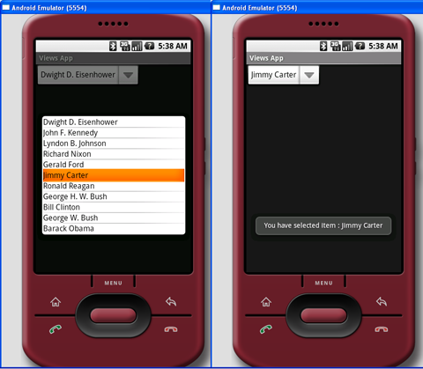
Selection Widgets
Example 2. Using the Spinner
When an item in the Spinner view is selected, you will use the Toast class to display the item selected.

Slide 15
Selection Widgets Example 2
Example 2. Using the Spinner
Add a new file to the res/layout folder and name it as spinner.xml
<?xml version="1.0" encoding="utf-8"?>
<LinearLayout xmlns:android="http://schemas.android.com/apk/res/android"
android:orientation="vertical"
android:layout_width="fill_parent"
android:layout_height="fill_parent"
>
<Spinner
android:id="@+id/spinner1"
android:layout_width="wrap_content"
android:layout_height="wrap_content"
android:drawSelectorOnTop="true" />
</LinearLayout>

Slide 16
Selection Widgets Example 2
Example 2. Using the Spinner
package net.learn2develop.AndroidViews;
import android.app.Activity;
import android.os.Bundle;
import android.view.View;
import android.widget.AdapterView;
import android.widget.ArrayAdapter;
import android.widget.Spinner;
import android.widget.Toast;
import android.widget.AdapterView.OnItemSelectedListener;
public class SpinnerExample extends Activity
{ String[] presidents = {
"Dwight D. Eisenhower", "John F. Kennedy",
"Lyndon B. Johnson", "Richard Nixon",
"Gerald Ford", "Jimmy Carter",
"Ronald Reagan", "George H. W. Bush",
"Bill Clinton", "George W. Bush",
"Barack Obama"
} ;

Slide 17
Selection Widgets Example 2
Example 2. Using the Spinner
Spinner s1;
@Override
public void onCreate(Bundle savedInstanceState)
{
super.onCreate(savedInstanceState);
setContentView(R.layout.spinner);
s1 = (Spinner) findViewById(R.id.spinner1);
ArrayAdapter<String> adapter = new ArrayAdapter<String>(this,
android.R.layout.simple_spinner_item, presidents);
s1.setAdapter(adapter);
s1.setOnItemSelectedListener(new OnItemSelectedListener()
{
public void onItemSelected(AdapterView<?> arg0,
View arg1, int arg2, long arg3)
{
int index = s1.getSelectedItemPosition();
Toast.makeText(getBaseContext(),
"You have selected item : " + presidents[index],
Toast.LENGTH_SHORT).show();
}
public void onNothingSelected(AdapterView<?> arg0) {}
});
}
}
The above program creates an ArrayAdapter object and associates it with the Spinner view. When an item in the Spinner view is selected, you will use the Toast class to display the item selected

Slide 18
Selection Widgets Example 2
Modify the AndroidManifest.xml
<?xml version="1.0" encoding="utf-8"?>
<manifest xmlns:android="http://schemas.android.com/apk/res/android"
package="net.learn2develop.AndroidViews"
android:versionCode="1"
android:versionName="1.0.0">
<application android:icon="@drawable/icon" android:label="@string/app_name">
<activity android:name=".ViewsActivity"
android:label="@string/app_name">
<intent-filter>
<action android:name="android.intent.action.MAIN" />
<category android:name="android.intent.category.LAUNCHER" />
</intent-filter>
</activity>
<activity android:name=".SpinnerExample"
android:label="@string/app_name" />
</application>
</manifest>

Slide 19
Selection Widgets
Modify the ViewsActivity.java file to start the SpinnerExample activity
package net.learn2develop.AndroidViews;
import android.app.Activity;
import android.content.Intent;
import android.os.Bundle;
public class ViewsActivity extends Activity
{
/** Called when the activity is first created. */
@Override
public void onCreate(Bundle savedInstanceState) {
super.onCreate(savedInstanceState);
startActivity(new Intent(this, SpinnerExample.class));
}
}

Slide 20
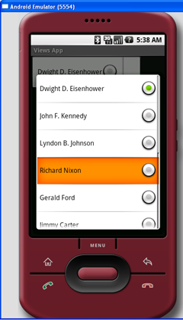
Selection Widgets
Display item in Spinner using radio buttons
ArrayAdapter<String> adapter = new ArrayAdapter<String>(this, android.R.layout.simple_spinner_dropdown_item, presidents);

Slide 21
Selection Widgets
AutoCompleteTextView
With auto-completion, as the user types, the text is treated as a prefix filter, comparing the entered text as a prefix against a list of candidates.
Matches are shown in a selection list that, like with Spinner, folds down from the field.
The user can either type out a new entry (e.g., something not in the list) or choose an entry from the list to be the value of the field.
AutoCompleteTextView subclasses EditText, so you can configure all the standard look-and-feel aspects, such as font face and color.
AutoCompleteTextView has a android:completionThreshold property, to indicate the minimum number of characters a user must enter before the list filtering begins.

Slide 22
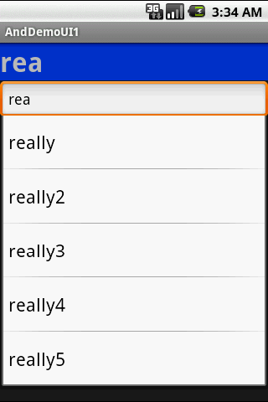
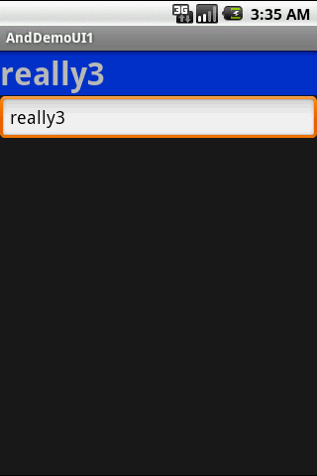
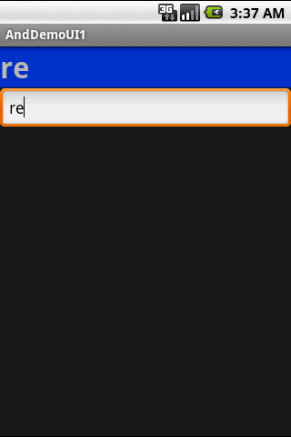
Selection Widgets
AutoCompleteTextView
Select this

Slide 23
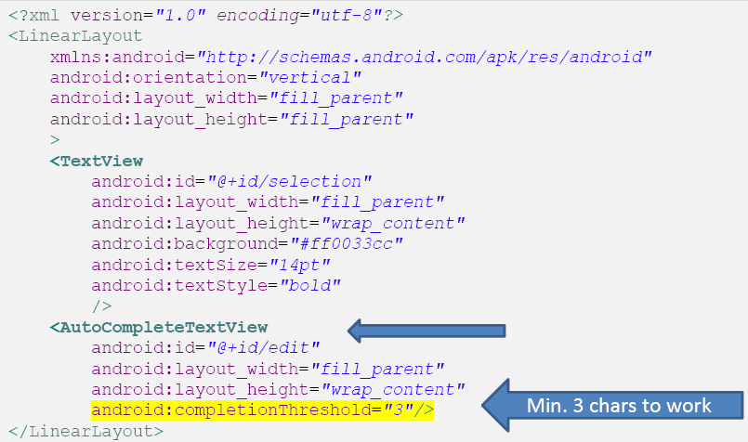
Selection Widgets
Example 3. AutoCompleteTextView

Slide 24
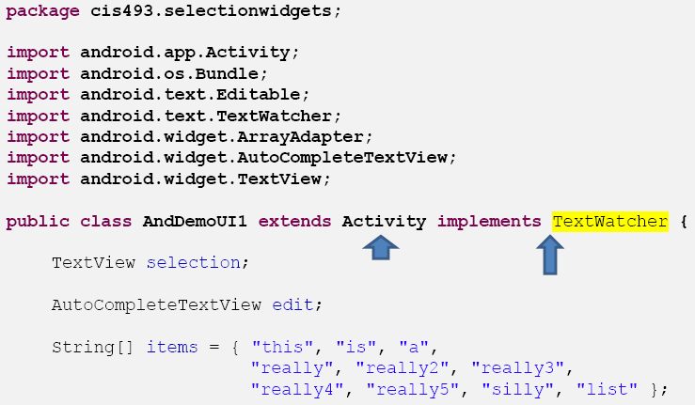
Selection Widgets
Example 3. AutoCompleteTextView

Slide 25
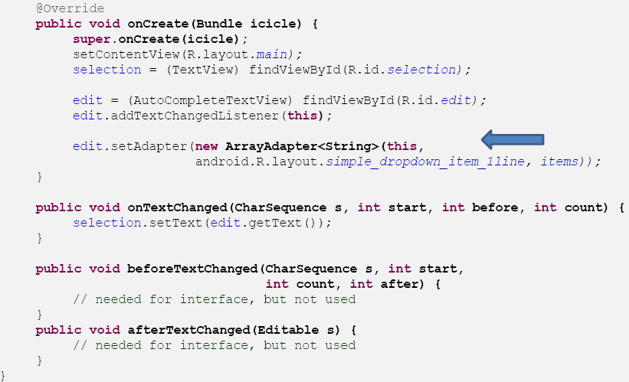
Selection Widgets
Example 3. AutoCompleteTextView

Slide 26
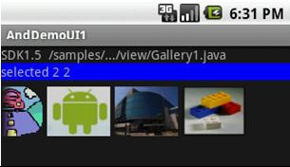
Selection Widgets Gallery Views
The Gallery widget provides a set of options depicted as images.
Image choices are offered on a contiguous horizontal mode, you may scroll across the image-set.
The programmer must supply an ImageAdapter to indicate what to do when an individual image is selected/clicked.

Slide 27
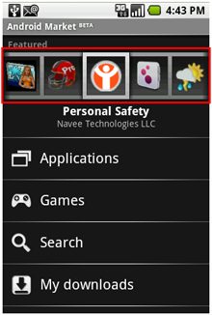
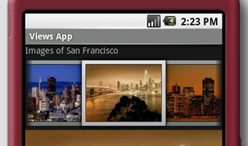
Selection Widgets Gallery Views
Example 4 : The Gallery is a view that shows items (such as images) in a center-locked, horizontal scrolling list.

Slide 28
Selection Widgets Gallery Views
To see how the Gallery view works, add a new file to the res/layout folder and name it as displayview.xml
<?xml version="1.0" encoding="utf-8"?>
<LinearLayout xmlns:android="http://schemas.android.com/apk/res/android"
android:orientation="vertical"
android:layout_width="fill_parent"
android:layout_height="fill_parent"
>
<TextView
android:layout_width="fill_parent"
android:layout_height="wrap_content"
android:text="Images of San Francisco" />
<Gallery
android:id="@+id/gallery1"
android:layout_width="fill_parent"
android:layout_height="wrap_content" />
<ImageView
android:id="@+id/image1"
android:layout_width="320px"
android:layout_height="250px"
android:scaleType="fitXY" />
</LinearLayout>

Slide 29
Selection Widgets Gallery Views
Add a new file to the res/values folder and name it as attrs.xml
<?xml version="1.0" encoding="utf-8"?>
<resources>
<declare-styleable name="Gallery1">
<attr name="android:galleryItemBackground" />
</declare-styleable>
</resources>

Slide 30
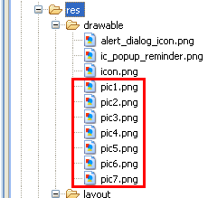
Selection Widgets Gallery Views
Add a few images to the res/drawable folder

Slide 31
Selection Widgets Gallery Views
Add a new class to the src/net.learn2develop.AndroidViews folder and name it as DisplayViewsExample.java
package net.learn2develop.AndroidViews;
import android.app.Activity;
import android.content.Context;
import android.content.res.TypedArray;
import android.os.Bundle;
import android.view.View;
import android.view.ViewGroup;
import android.widget.AdapterView;
import android.widget.BaseAdapter;
import android.widget.Gallery;
import android.widget.ImageView;
import android.widget.Toast;
import android.widget.AdapterView.OnItemClickListener;
public class DisplayViewsExample extends Activity
{
//---the images to display---
Integer[] imageIDs = {
R.drawable.pic1,
R.drawable.pic2,
R.drawable.pic3,
R.drawable.pic4,
R.drawable.pic5,
R.drawable.pic6,
R.drawable.pic7
};

Slide 32
Selection Widgets Gallery Views
@Override
public void onCreate(Bundle savedInstanceState)
{ super.onCreate(savedInstanceState);
setContentView(R.layout.displayview);
Gallery gallery = (Gallery) findViewById(R.id.gallery1);
gallery.setAdapter(new ImageAdapter(this));
gallery.setOnItemClickListener(new OnItemClickListener()
{
public void onItemClick(AdapterView parent,
View v, int position, long id)
{
//Toast.makeText(getBaseContext(), "pic" + (position + 1) + " selected", //Toast.LENGTH_SHORT).show();
//---display the images selected---
ImageView imageView = (ImageView) findViewById(R.id.image1);
imageView.setImageResource(imageIDs[position]);
}
});
}

Slide 33
Selection Widgets Gallery Views
public class ImageAdapter extends BaseAdapter
{
private Context context;
private int itemBackground;
public ImageAdapter(Context c)
{
context = c;
//---setting the style---
TypedArray a = obtainStyledAttributes(R.styleable.Gallery1);
itemBackground = a.getResourceId(
R.styleable.Gallery1_android_galleryItemBackground, 0);
a.recycle();
}
//---returns the number of images---
public int getCount() {
return imageIDs.length;
}

Slide 34
Selection Widgets Gallery Views
//---returns the ID of an item---
public Object getItem(int position) {
return position;
}
public long getItemId(int position) {
return position;
}
//---returns an ImageView view---
public View getView(int position, View convertView, ViewGroup parent) {
ImageView imageView = new ImageView(context);
imageView.setImageResource(imageIDs[position]);
imageView.setScaleType(ImageView.ScaleType.FIT_XY);
imageView.setLayoutParams(new Gallery.LayoutParams(150, 120));
imageView.setBackgroundResource(itemBackground);
return imageView;
}
}
}
You create the ImageAdapter class (which extends the BaseAdapter class) so that it can bind to the Gallery view with a series of ImageView views.
The ImageView view is used to display images.
When an image in the Gallery view is selected (or clicked), the position of the image selected is displayed.

Slide 35
Selection Widgets Gallery Views
Modify the AndroidManifest.xml file to register the new activity
<?xml version="1.0" encoding="utf-8"?>
<manifest xmlns:android="http://schemas.android.com/apk/res/android"
package="net.learn2develop.AndroidViews"
android:versionCode="1"
android:versionName="1.0.0">
<application android:icon="@drawable/icon" android:label="@string/app_name">
<activity android:name=".ViewsActivity"
android:label="@string/app_name">
<intent-filter>
<action android:name="android.intent.action.MAIN" />
<category android:name="android.intent.category.LAUNCHER" />
</intent-filter>
</activity>
<activity android:name=".DisplayViewsExample"
android:label="@string/app_name" />
</application>
</manifest>

Slide 36
Selection Widgets Gallery Views
Modify the ViewsActivity.java file as follows to start the DisplayViewsExample activity
public class ViewsActivity extends Activity
{
/** Called when the activity is first created. */
@Override
public void onCreate(Bundle savedInstanceState) {
super.onCreate(savedInstanceState);
setContentView(R.layout.main);
startActivity(new Intent(this, DisplayViewsExample.class));
}
}

Slide 37
Selection Widgets GridView
The GridView view shows items in two-dimensional scrolling grid.
You can use the GridView view together with ImageView views to display a series of images.

Slide 38
Selection Widgets GridView
GridViewSome properties used to determine the number of columns and their sizes:
android:numColumns spells out how many columns there are, or, if you supply a value of auto_fit, Android will compute the number of columns based on available space and the properties listed below.
android:vertical Spacing and its counterpart android:horizontalSpacingindicate how much whitespace there should be between items in the grid.
android:columnWidth indicates how many pixels wide each column should be.
android:stretchMode indicates, for grids with auto_fit for android:numColumns, what should happen for any available space not taken up by columns or spacing .

Slide 39
Selection Widgets GridView
Example: Fitting the View
Suppose the screen is 320pixels wide, and we have
android:columnWidth set to 100px and
android:horizontalSpacing set to 5px.
Three columns would use 310pixels (three columns of 100 pixels and two whitespaces of 5 pixels).
With android:stretchMode set to columnWidth, the three columns will each expand by 3-4 pixels to use up the remaining 10 pixels.
With android:stretchMode set to spacingWidth, the two internal whitespaces will each grow by 5 pixels to consume the remaining 10 pixels.

Slide 40
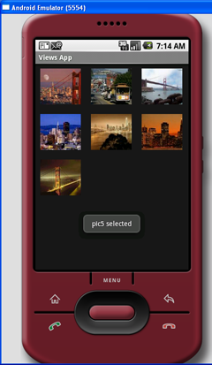
Selection Widgets GridView
Example 5

Slide 41
Selection Widgets GridView
Modify the displayview.xml file
<?xml version="1.0" encoding="utf-8"?>
<GridView xmlns:android="http://schemas.android.com/apk/res/android"
android:id="@+id/gridview"
android:layout_width="fill_parent"
android:layout_height="fill_parent"
android:numColumns="auto_fit"
android:verticalSpacing="10dp"
android:horizontalSpacing="10dp"
android:columnWidth="90dp"
android:stretchMode="columnWidth"
android:gravity="center"
/>

Slide 42
Selection Widgets GridView
package net.learn2develop.AndroidViews;
import android.app.Activity;
import android.content.Context;
import android.os.Bundle;
import android.view.View;
import android.view.ViewGroup;
import android.widget.AdapterView;
import android.widget.BaseAdapter;
import android.widget.GridView;
import android.widget.ImageView;
import android.widget.Toast;
import android.widget.AdapterView.OnItemClickListener;
public class DisplayViewsExample extends Activity
{
//---the images to display---
Integer[] imageIDs = {
R.drawable.pic1,
R.drawable.pic2,
R.drawable.pic3,
R.drawable.pic4,
R.drawable.pic5,
R.drawable.pic6,
R.drawable.pic7
};
Notes:
@Override
public void onCreate(Bundle savedInstanceState)
{
super.onCreate(savedInstanceState);
setContentView(R.layout.displayview);
GridView gridView = (GridView) findViewById(R.id.gridview);
gridView.setAdapter(new ImageAdapter(this));
gridView.setOnItemClickListener(new OnItemClickListener()
{
public void onItemClick(AdapterView parent,
View v, int position, long id)
{
Toast.makeText(getBaseContext(),
"pic" + (position + 1) + " selected",
Toast.LENGTH_SHORT).show();
}
});
}

Slide 43
Selection Widgets GridView
You create the ImageAdapter class (which extends the BaseAdapter class) so that it can bind to the Gallery view with a series of ImageView views.
The ImageView view is used to display images.
When an image in the Gallery view is selected (or clicked), the position of the image selected is displayed.
@Override
public void onCreate(Bundle savedInstanceState)
{
super.onCreate(savedInstanceState);
setContentView(R.layout.displayview);
GridView gridView = (GridView) findViewById(R.id.gridview);
gridView.setAdapter(new ImageAdapter(this));
gridView.setOnItemClickListener(new OnItemClickListener()
{
public void onItemClick(AdapterView parent,
View v, int position, long id)
{
Toast.makeText(getBaseContext(), "pic" + (position + 1) + " selected", Toast.LENGTH_SHORT).show();
}
});
}

Slide 44
Selection Widgets GridView
public class ImageAdapter extends BaseAdapter
{
private Context context;
public ImageAdapter(Context c)
{
context = c;
}
//---returns the number of images---
public int getCount() {
return imageIDs.length;
}
//---returns the ID of an item---
public Object getItem(int position) {
return position;
}
public long getItemId(int position) {
return position;
}

Slide 45
Selection Widgets GridView
//---returns an ImageView view---
public View getView(int position, View convertView, ViewGroup parent)
{
ImageView imageView;
if (convertView == null) {
imageView = new ImageView(context);
imageView.setLayoutParams(new GridView.LayoutParams(85, 85));
imageView.setScaleType(ImageView.ScaleType.CENTER_CROP);
imageView.setPadding(5, 5, 5, 5);
} else {
imageView = (ImageView) convertView;
}
imageView.setImageResource(imageIDs[position]);
return imageView;
}
}
}

